Slide 2
WELCOME!
NEW CAGOW ATTENDEES
Mark Heller ’70
Alumni Council Representative
CAGOW 2017: NEW LEADER WELCOME AND ORIENTATION

Slide 3
ALUMNI ADVISORS
Volunteer Lead: Mark Heller ’70 mheller@fodorco.com
Clubs: Mark Heller ’70 mheller@fodorco.com
Mark Cormier ‘82 cormier1@pacbell.net
Stina Brock ’01 stina.brock@gmail.com
Groups: Hillary S. Cheng ‘ 11 hillary.s.cheng@gmail.com
Vanessa Ferro ‘00 vmferro@mac.com
Staff Lead: Magda Vergara magda.t.vergara@Dartmouth.edu
CAGOW 2017: NEW LEADER WELCOME AND ORIENTATION

Slide 4
ALUMNI COMMUNITIES TEAM
Victoria Gonin P ‘12
Deputy Director
Alumni Relations
Anita Brown Administrative Assistant
Theodosia Cook
Assistant Director
Special Projects
Mark Hoffman, JD
Associate Director
Operations
Magda Vergara, PhD
Associate Director
Communities
CAGOW 2017: NEW LEADER WELCOME AND ORIENTATION

Slide 5
INTRODUCTIONS
Name, Year, Club or Group
What is your role?
Why are you involved as an alumnus/a?
Why did you choose to attend CAGOW?
What do you hope to learn from attending CAGOW?
CAGOW 2017: NEW LEADER WELCOME AND ORIENTATION

Slide 6
Communities of Dartmouth Alumni
CEC- history and composition
Alumni Council
Clubs
Groups
Affiliated Groups
Shared Interest Groups
Women of Dartmouth
CAGOW 2017: NEW LEADER WELCOME AND ORIENTATION

Slide 7
Shared Interest Groups
Opportunities for alumni to connect and reconnect to fellow alumni based on common interests:
Dartmouth Alumni in Design and Architecture (DADA) Corinna Knight ’93 and Susan Reed ‘81
Dartmouth Alumni in Entertainment & Media (DAEMA) Schuyler Evans ’10 and Anna-Kay Thomas ‘12
Dartmouth Lawyers Association (DLA) Howard Morse ’81
Dartmouth Uniformed Service Alumni (DUSA) Winnie Huang ’92
CAGOW 2017: NEW LEADER WELCOME AND ORIENTATION

Slide 8
Affiliated Groups
The personal-identity groups that Dartmouth recognizes as alumni affiliated organizations are based on ethnicity and sexual orientation.
Black Alumni of Dartmouth Association (BADA) Leah Threatte Bojnowski ’01
Dartmouth Asian Pacific American Alumni Association (DAPAAA) Fang Li ’05 and Ariel Xue ’08
Dartmouth Association of Latino Alumni (DALA) Fernando de Necochea ’62
Dartmouth Gay, Lesbian, Bisexual and Transgender Alumni/ae Association (DGALA) Brendan Connell ’87
Native American Alumni Association of Dartmouth (NAAAD) Terra Branson ’10 and Maxine Mauricio ’93

Slide 9
Women of Dartmouth
Women of Dartmouth | Dartmouth Alumni
WoD communities in the U.S. and abroad:
Greater Boston
Bay Area
Chicago
Greater New York
London, UK
Washington D.C.
Southern California
CAGOW 2017: NEW LEADER WELCOME AND ORIENTATION

Slide 10
GETTING THE MOST FROM CAGOW
CAGOW
Alumni website: An excellent resource after CAGOW
CAGOW schedule
Highlight sessions
Updates
CAGOW – shared insights, especially in conjunction with new leader CAGOW hopes
Mark Heller
Resource Group (tent)
Other leaders
Questions
CAGOW 2017: NEW LEADER WELCOME AND ORIENTATION

Slide 11
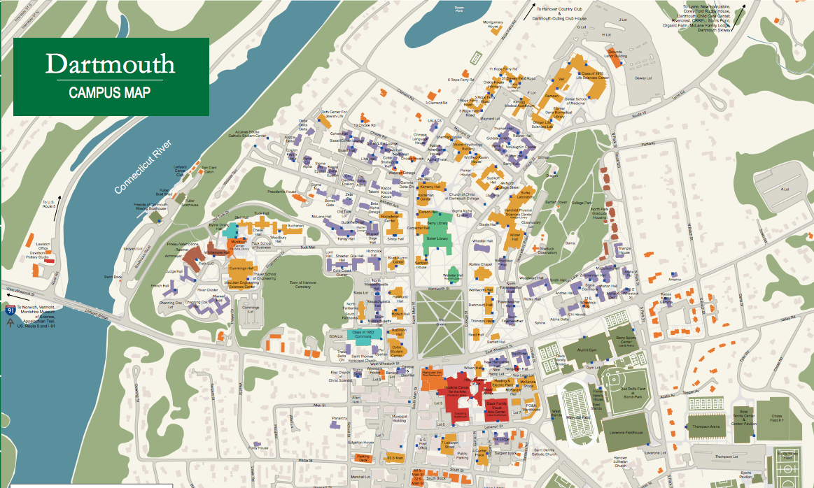
INSERT CAMPUS MAP
CAGOW 2016: NEW LEADER WELCOME AND ORIENTATION

Slide 12
RESOURCES AFTER CAGOW
CEC email- the answers to all your questions!
Communities.executive.council@Dartmouth.edu
CAGOW 2017: NEW LEADER WELCOME AND ORIENTATION

Slide 13
RESOURCES AFTER CAGOW
Communities Team: Monthly updates
Club/Group Activity Report (CGAR): all reports, past and present
Alumni Relations Website:
Staff listing, Events Calendar, Learn & Travel, DAM,
Club/Group Resources (event toolkit, speaker request form, communications, finances, webinars, etc.)
Contact Sheets: Dartmouth Clubs and Groups, Ivy+
Update alumni directory
CAGOW 2017: NEW LEADER WELCOME AND ORIENTATION

Slide 14
USEFUL LINKS
Alumni Relations Web Site
Club and Group Resources
Alumni Directory
Contact Us
Classes
The content and functionality of Dartmouth alumni class Web sites
Clubs – Alumni
Dartmouth APP: IDartmouth
CAGOW 2017: NEW LEADER WELCOME AND ORIENTATION

Slide 15
MORE USEFUL LINKS
Dartmouth Now
The Dartmouth
Office of Communications
Dartmouth Alumni Magazine Facebook
LinkedIn Twitter Flickr
Instagram
http://now.dartmouth.edu/subscribe/
http://thedartmouth.com/
http://www.dartmouth.edu/~opa/
http://dartmouthalumnimagazine.com/
https://www.facebook.com/dartmouthalumni
http://www.linkedin.com/groups/Dartmouth-College-Alumni-46349/about
https://twitter.com/dartmouthalumni
http://www.flickr.com/photos/dartmouth_alumni_events/
https://www.instagram.com/dartmouthalumni/
CAGOW 2017: NEW LEADER WELCOME AND ORIENTATION

Slide 16
Q & A
How can I get help with iModules?
Whom can I contact regarding the Operating Guidelines?
How can I find other clubs like mine and learn about what’s working for them?
Where can I get help with financial or non-profit status questions I have?
Whom can I talk to about getting a College speaker (professor, etc.) to come to our Club?
How can I find out about sports teams that will be in my area?
How can I more effectively use social media for my Club?
Etc.
CAGOW 2017: NEW LEADER WELCOME AND ORIENTATION

Slide 17
THANK YOU!
CAGOW 2017: NEW LEADER WELCOME AND ORIENTATION

