Slide 1
An Introduction to Quickbase
Quickbase is an online system and database used to track dues payments and alumni information for each class.

Slide 2
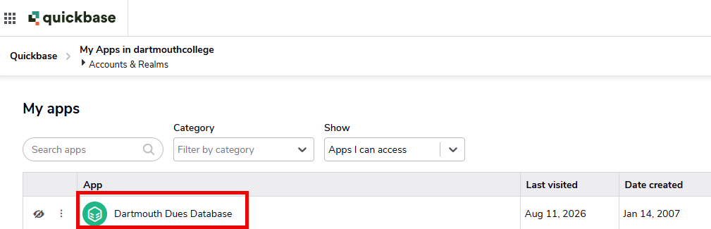
Login
You should have received an email from notify@quickbase.com inviting you to log into Quickbase. Click the link and follow the instructions to set up your account.
  Didn’t get an invite or link expired? Contact Volunteer.Engagement@dartmouth.edu
Once your account is setup, the URL to access Quickbase is https://dartmouthcollege.quickbase.com/
Log in using your email address and password
Click on “Dartmouth Dues Database”

Slide 3
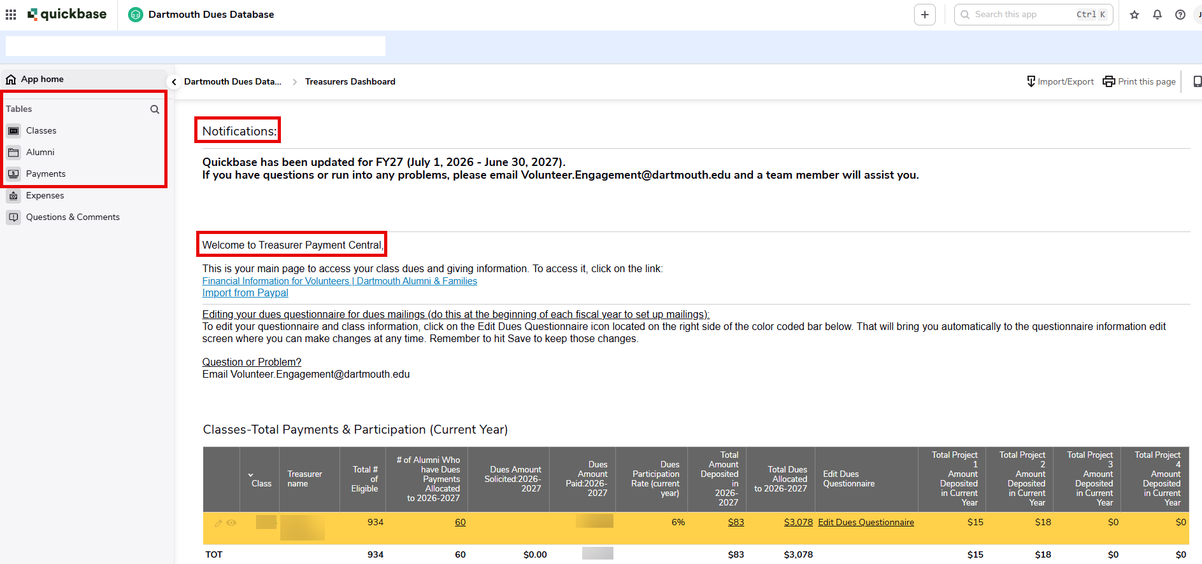
Home Page
Notifications
  This will change throughout the year based on important information Alumni Relations needs to share.
  When Ledyard payments are posted, it will be noted in this section.
Welcome to Treasurer Payment Central
  Financial Information for Volunteers – This link directs you to resources for class, club, and group financial leaders.
  Import from Paypal – Process to import files for your class
Tables (on the left side)
  Click to navigate to Classes | Alumni | Payments tables

Slide 4
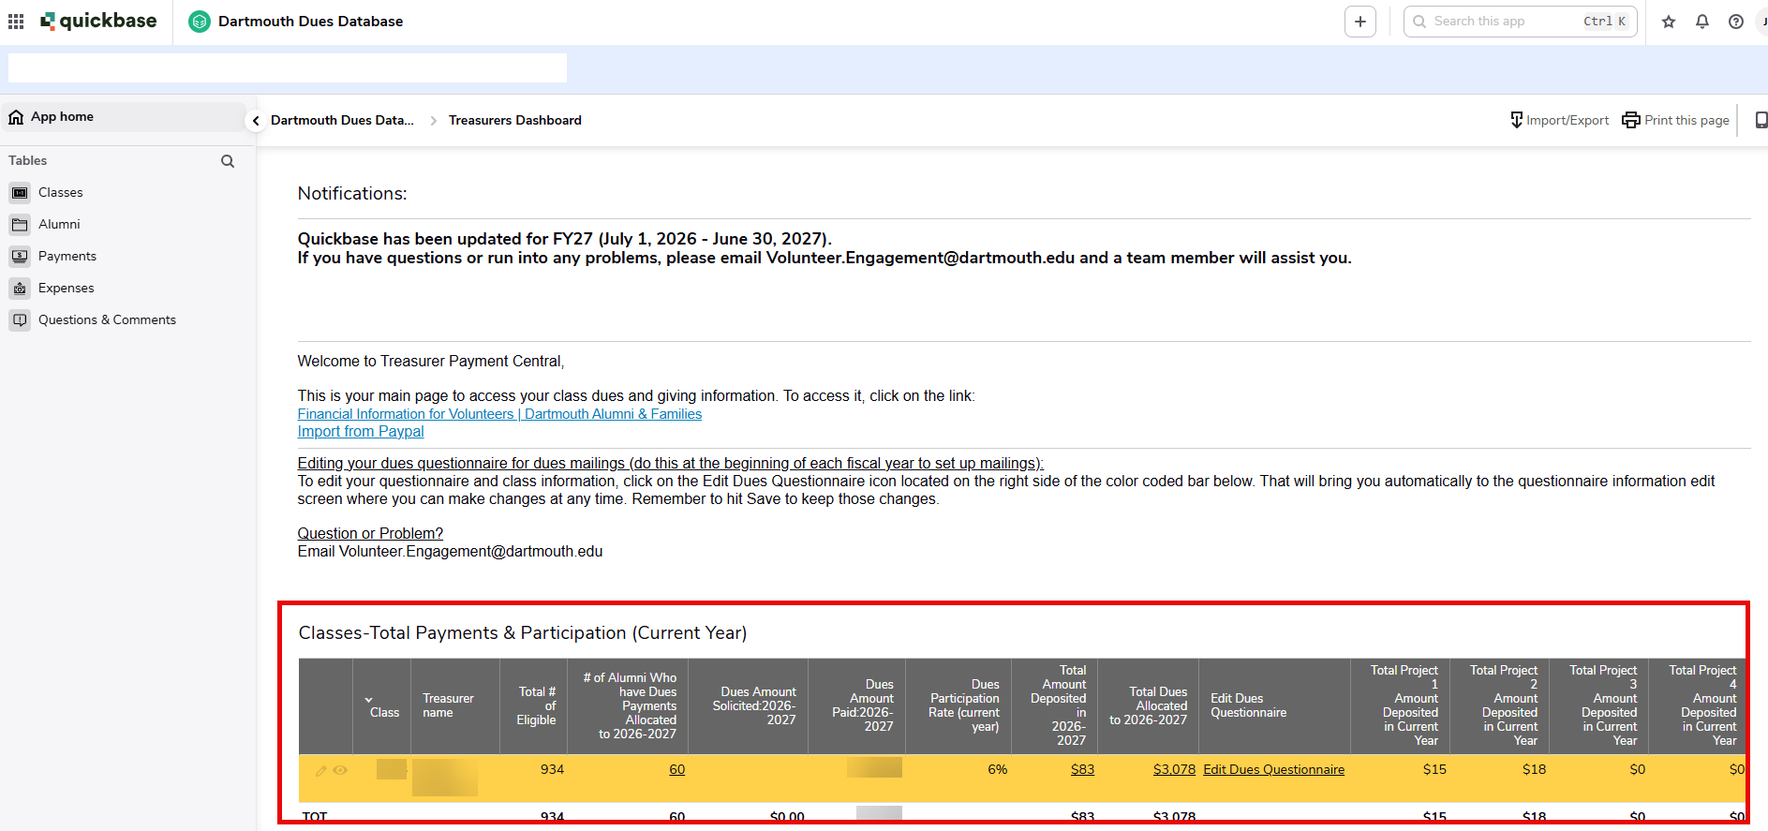
Home Page – Payments & Participation
Classes – Total Payments & Participation (Current Year)
  This is a snapshot of your classes' participation statistics for the current year.
  Total # of eligible: This reflects all alumni in your class who are on active mailing list and have not asked to be excluded. This number is entered at the beginning of the fiscal year and is updated annually.
  Edit Dues Questionnaire: Click on this link to be taken to the Class page where you can update your class information and dues solicitation information. (See next page for details)

Slide 5
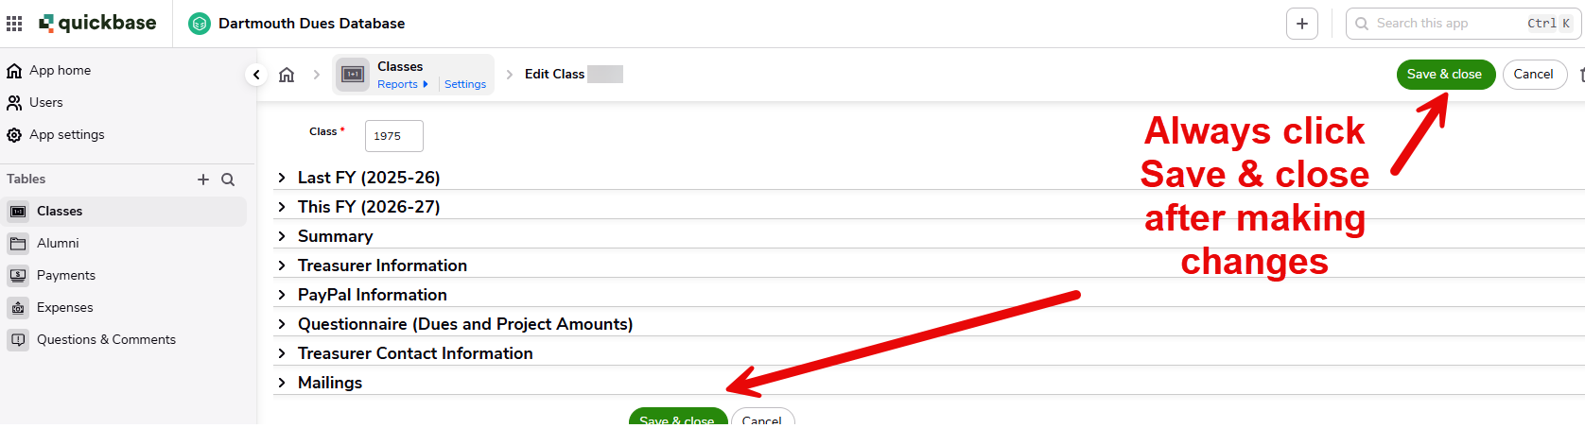
Edit Dues Questionnaire Link
Last FY and This FY Sections: View participation rates and summary information
Treasurer Information and Treasurer Contact Information: View and update for your class
PayPal Information: View and update for your class
Questionnaire (Dues and Project Amounts): Enter amounts you will be soliciting for dues and project(s) this FY
Mailings: Selection for which paper dues mailings you wish to send
Always Save & close after any changes

Slide 6
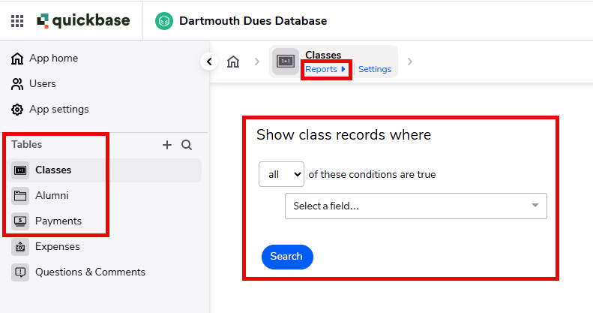
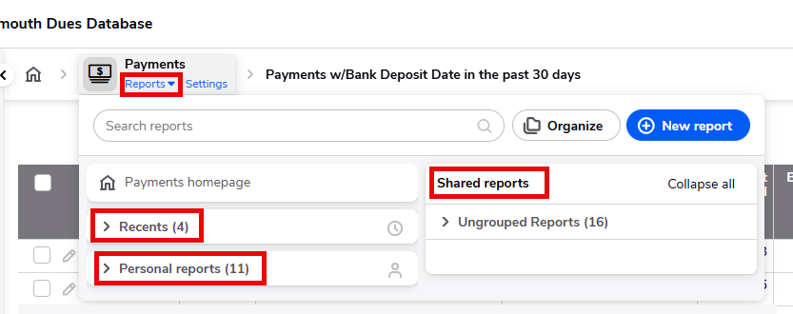
Tables: Classes, Alumni, and Payments
Each of the Table Links will bring you to a landing page where you can run a quick search based on available fields.
Click on the Reports link to access reports on each table.
Reports are saved in three categories:
  Recents – the most recent reports you have accessed
  Personal reports – reports you have created
  Shared reports – reports created by the Alumni Relations team.

Slide 7
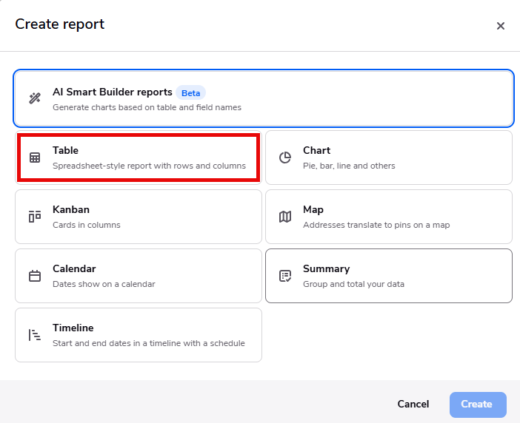
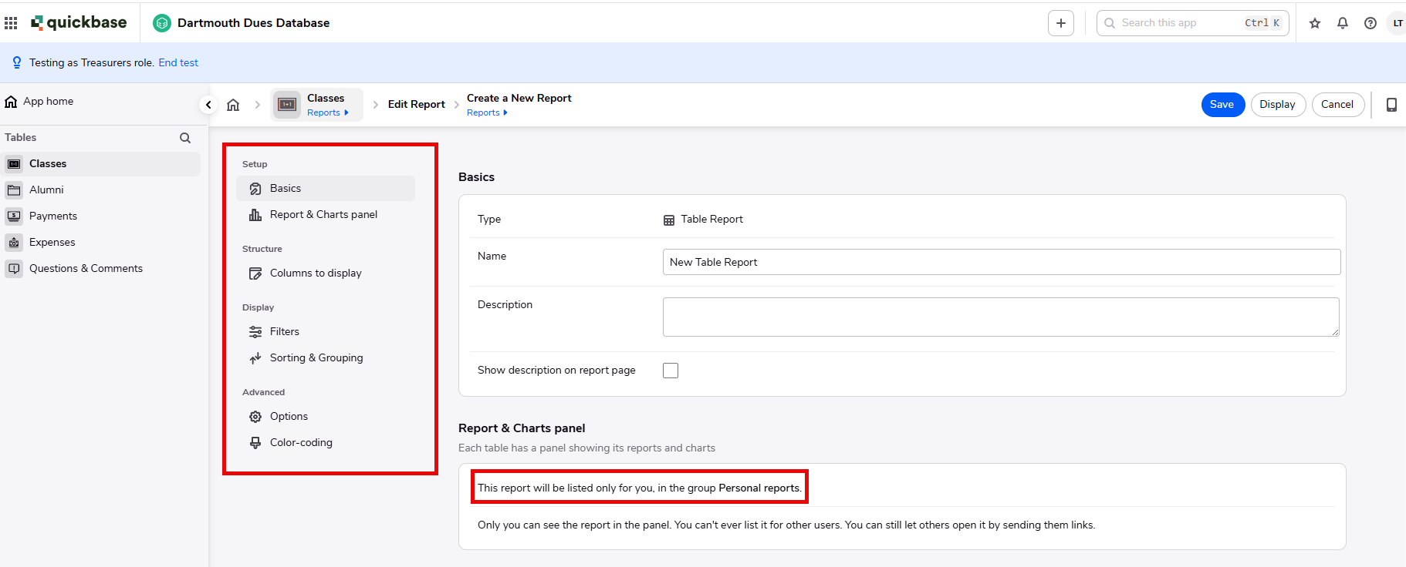
Creating Reports
You may at times wish to create your own report (e.g. you may want to see only surviving spouses, or only people who pay with PayPal, etc).
  When you create a new report, the first step is to choose a style, the most typical being Table.
  The report setup menu takes you through the various steps for filtering, sorting, and display options.
  A report you create will, by default be saved in your Personal Reports.

Slide 8
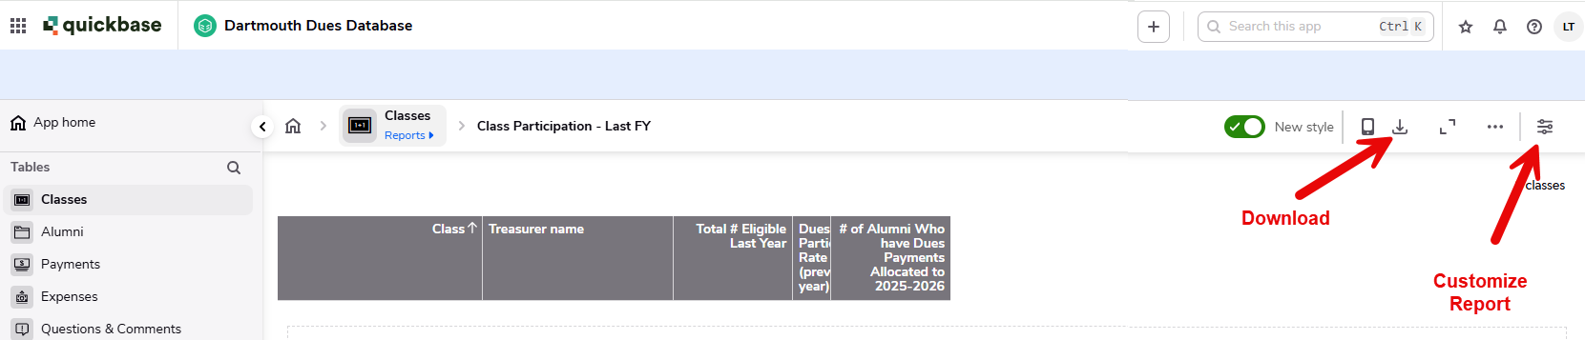
Reports – Downloading & Customizing
When you are in a report, you can easily download. It will download in a .csv file format which can be opened in MS Excel or Google Sheets.
You can also edit or customize a report to update things like display fields or filters.

Slide 9
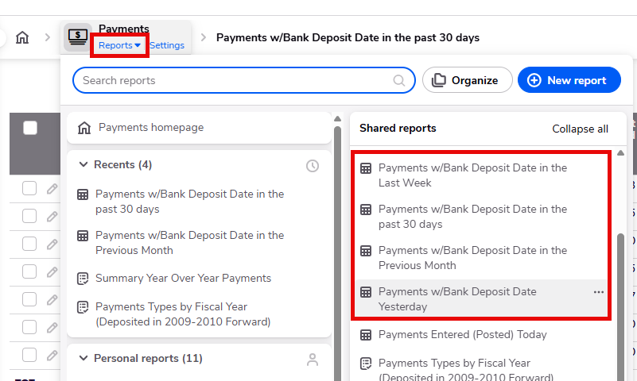
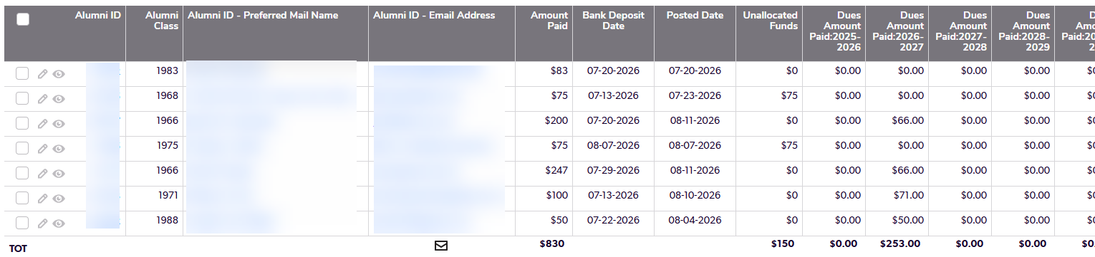
Adding a Payment – Classes Using Ledyard
If you are using a Ledyard Bank Account, the Alumni Relations office will post payments in Quickbase for you.
  Currently payments are posted monthly, we hope to shift to weekly once the Lighthouse service is working.
You may need to review or adjust payments to ensure they are allocated as the alum intended. The easiest way to do this is by running a report!
From the Payments Table you can use the Shared Report Payments w/Bank Deposit Date in XXXXX (Last Week, Past 30 Days, Previous Month are all saved reports)
  Each of these reports will show you a list of your classes' payments during that period, along with how that payment was allocated.
  (NOTE: Want to see a different field like a phone number? Customize the report to add the desired field!)

Slide 10
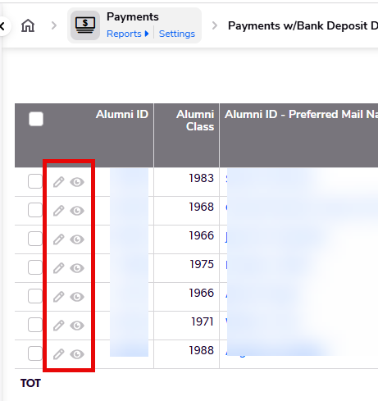
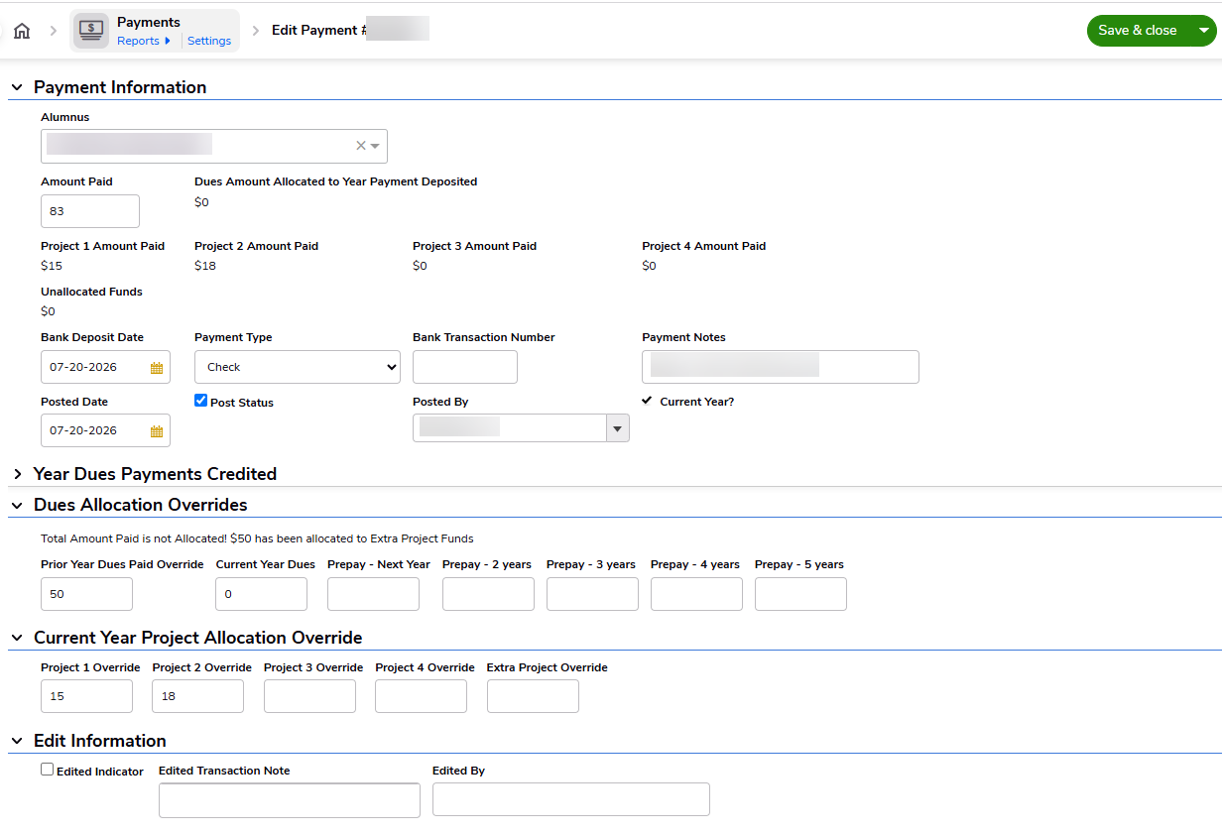
Adding a Payment – Classes Using Ledyard (Continued)
Now that you’re in a report, here is how to view and edit a payment!
  To View a payment’s details, click on the Eye Icon; To Edit, click on the Pencil Icon.
    This brings you to the payment details where you can view or edit information including payment allocation (e.g. alum intended to pay dues for the prior year, or a future year, or they wanted to allocate double on Project 2 but nothing on Project 1, etc)
  After any changes always Save & close

Slide 11
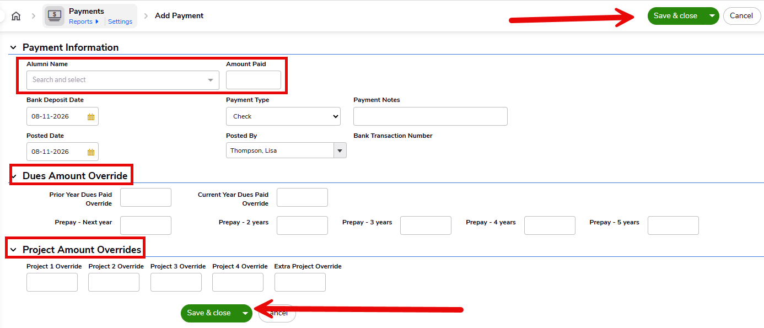
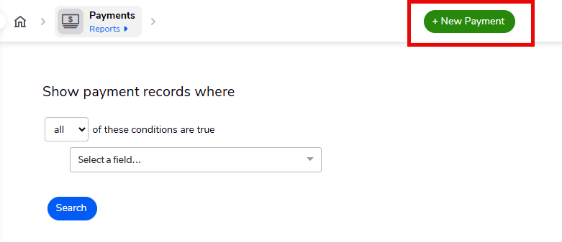
Adding a Payment – Not Ledyard Accounts
You are responsible for adding all dues payments into Quickbase.
Basic instructions:
  From the Payments Table:
    Click + New Payment
    Enter the Alumni Name (Note: This is a drop-down list, sorted by preferred mail name. You will only see names of your classmates.
    Enter Amount Paid
      NOTE: Quickbase will allocate all payments as follows:
      If you wish to manually allocate payment other than the default, enter amounts in the Dues Amount Override section.
  Adjust Bank Deposit Date and Payment Type if needed
  Always Save & close
1. Current Year Dues
2. Current Year Project(s)
3. Unallocated (leftover)

Slide 12
Questions?
https://alumni.dartmouth.edu/financial-information-volunteers
Volunteer.Engagement@dartmouth.edu

