Slide 1
Introduction to QuickBase
September 2025

Slide 2
The Big Picture
Review of the HOME page
  Key links
Edit Dues Questionnaire
  The key administrative page
Review of key tabs
  Alumni
  Payments
    Sharing a report
  Classes
Logging a payment

Slide 3
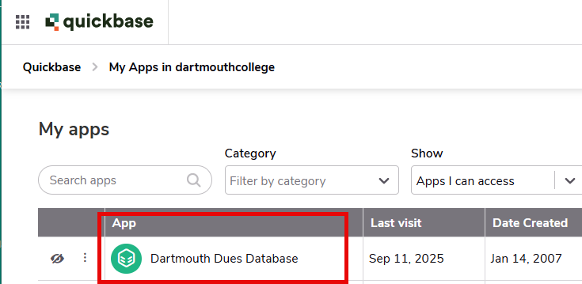
Home Page

Slide 4
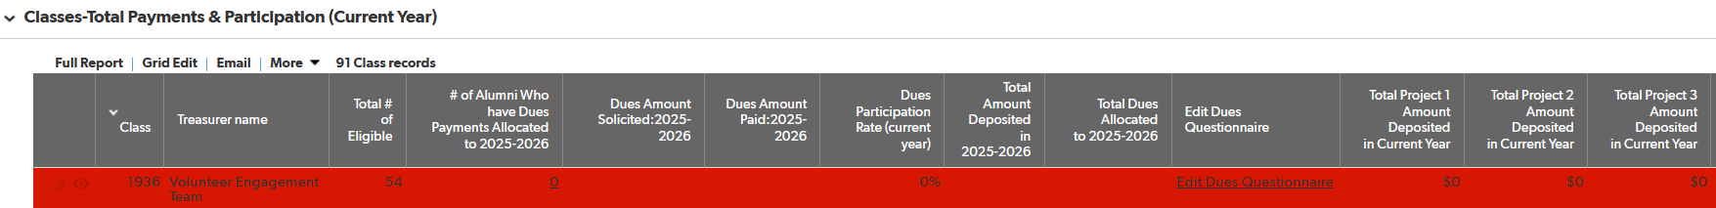
Home Page
The table below shows you current year payments
Total # eligible = all alumni on active mailing list and not asked to be excluded, updated monthly
Key administrative section

Slide 5
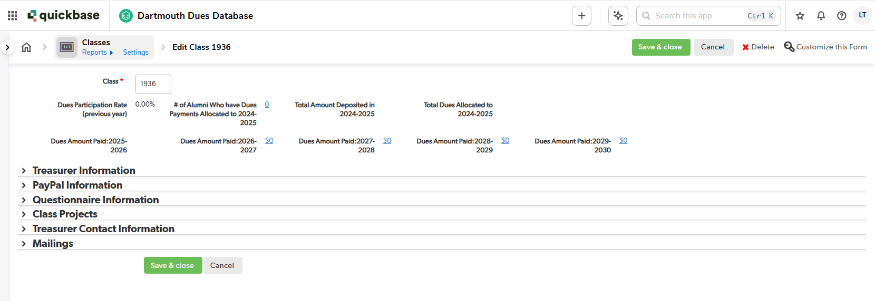
Edit Dues Questionnaire
*Key* item to remember: Save all changes
Click to expand section

Slide 6
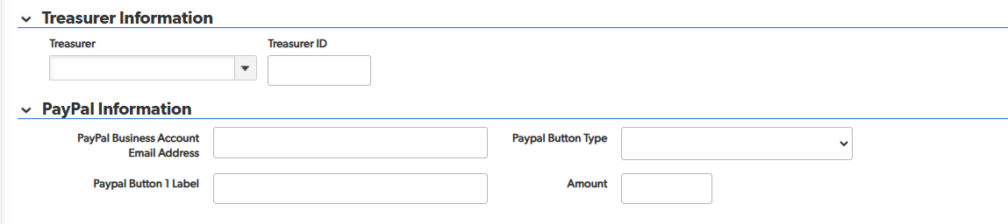
Edit Dues Questionnaire
Treasurer & PayPal Information
This is where Treasurer name and ID will be displayed
Enter PayPal information, if applicable

Slide 7
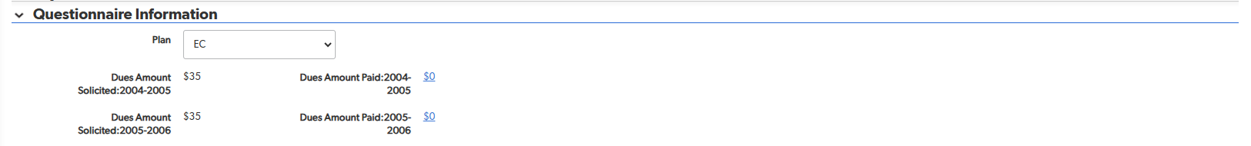
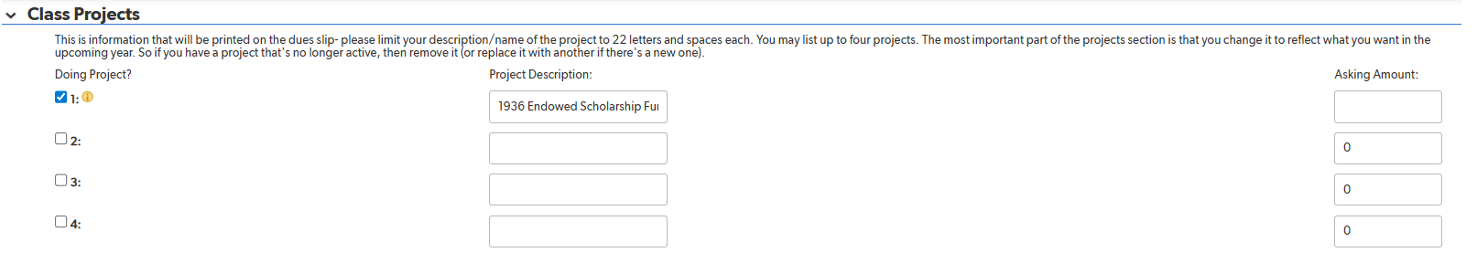
Edit Dues Questionnaire
Questionnaire & Class Project Information
Enter Dues Amount Solicited for current year
Select box to solicit for projects (up to 4)
Enter Project Description
Asking amount can be added or left blank

Slide 8
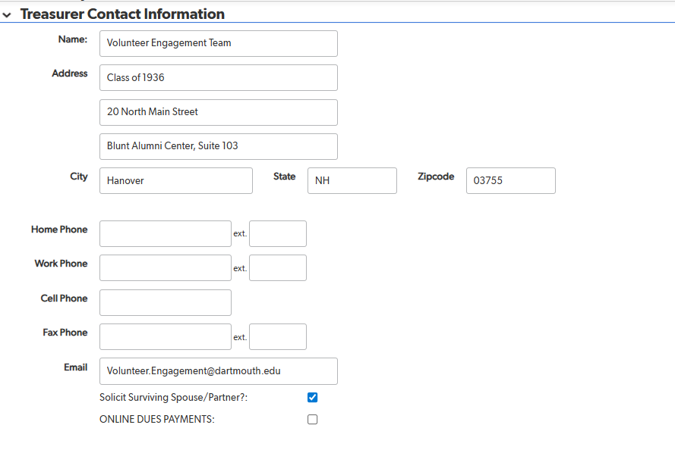
Edit Dues Questionnaire
Treasurer Contact Information
Enter or Update Contact Information
Select if class will solicit from Surviving Spouse/Partners

Slide 9
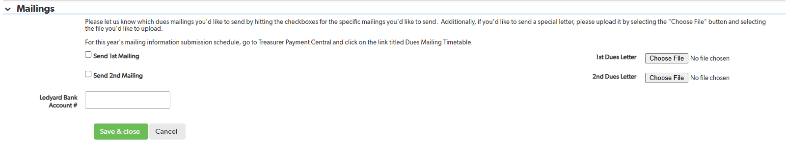
Edit Dues Questionnaire
Mailings
For snail mail dues mailings
Select mailings you wish to participate in.
Schedule of mailing deadlines is on treasurers website
Upload your snail mail dues requests letters here by clicking on “CHOOSE FILE”
Upload letters in Word
Sample letters are on the treasurers website

Slide 10
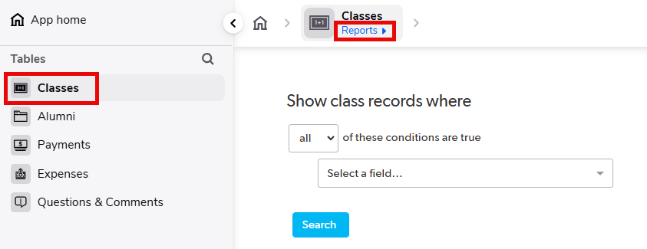
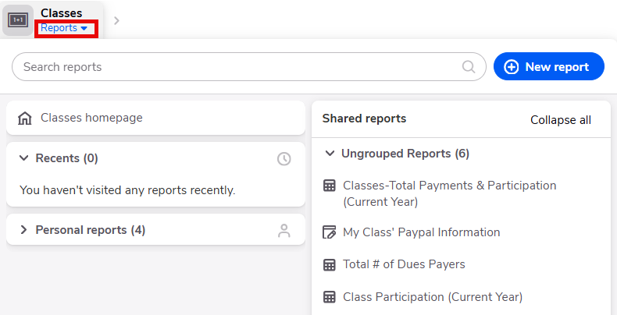
Classes
Shared vs. personal reports
  Shared are available to all classes
  Personal are YOUR reports you create

Slide 11
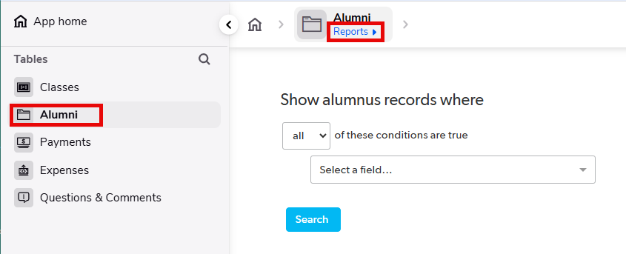
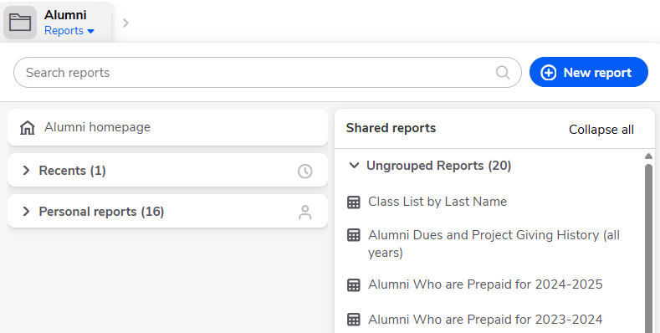
Alumni
Shared vs. personal reports
  Shared are available to all classes
  Personal are YOUR reports you create
LYBUNTS (last year but not this year)

Slide 12
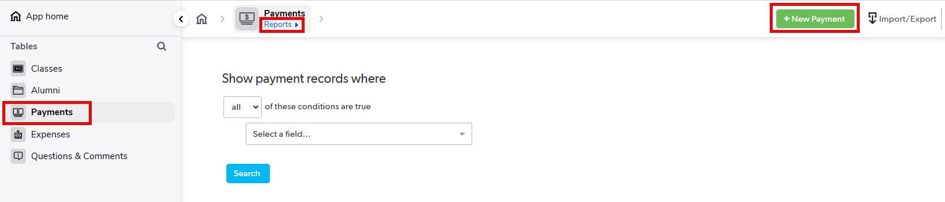
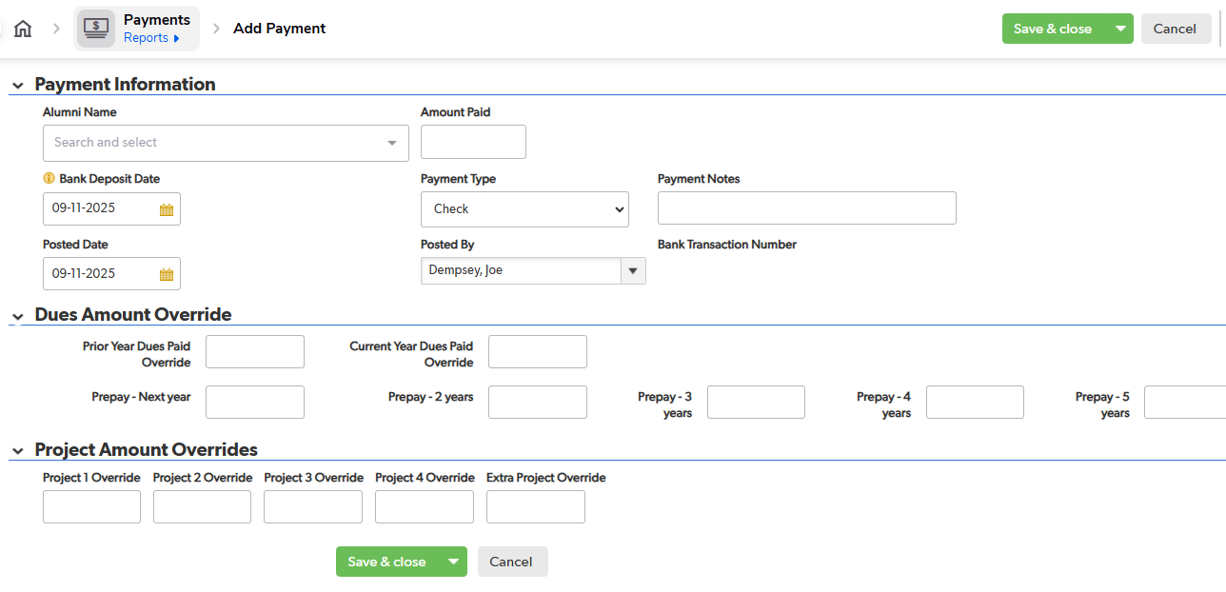
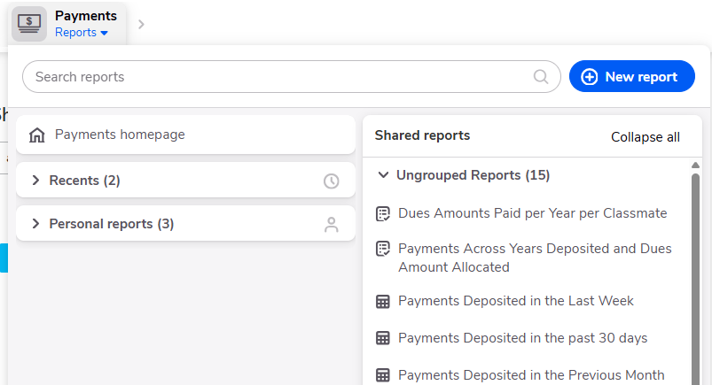
Payments

Slide 13
Payments – Add New Payment
Use the drop down box under Alumni ID to select the name of the paying classmate
Enter the Amount Paid (total)
Dues Amount Override can be used to allocate multiple dues payments by one person in a year OR prepayments of dues
  Set the $ amount in each box where you want the payment allocated
Project Amount Override can be used to allocate a payment to a specific project

Slide 14
Payments
Common vs. personal reports
  Has current and prior year payments
Key report: Payments Deposited in the Previous Month
  For Ledyard reconciliation
  Back out Paypal/direct checks to you
  Note for Wheelock treasurers: checks you input in QB after month end after depositing into the bank during the month end won’t reconcile
Can do personal reports here as well
Can add multiple search terms (go to far right (not visible here): you can ADD, DELETE and use OR (blue arrow) for your payment searches

Slide 15
Sharing a Report
You only have credentials for one person, the treasurer
You can share reports by converting and exporting them into Excel/CSV.

Slide 16
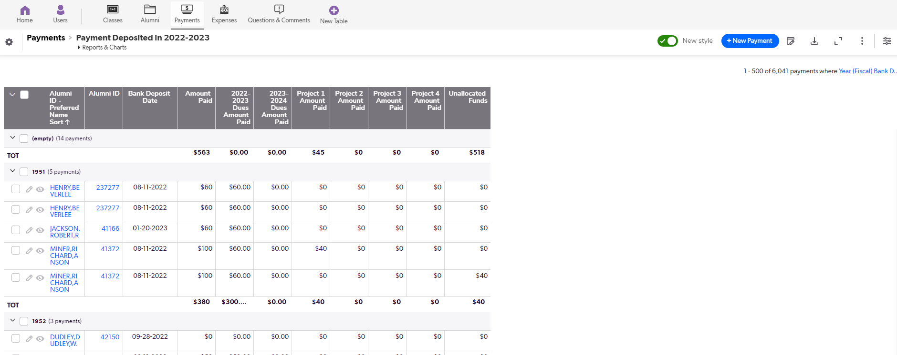
Sharing a Report, Continued
Report will be generated
Click on the circled icon to download

Slide 17
Thank you!

