Slide 1
Adding a PayPal account
Updated October 2022

Slide 2
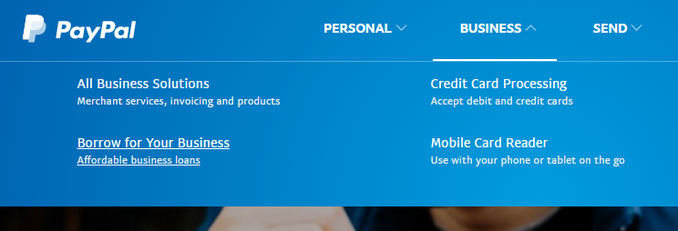
Go to PayPal.com
Up top, click Business, then Credit Card Processing

Slide 3
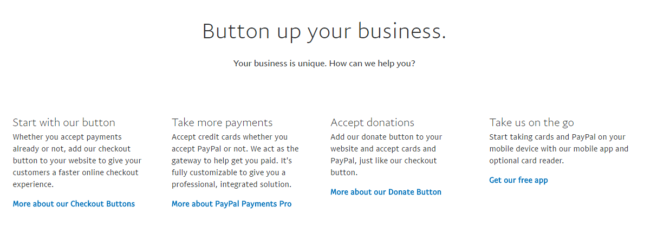
Scroll down...
Then click “More about our Donate Button”

Slide 4
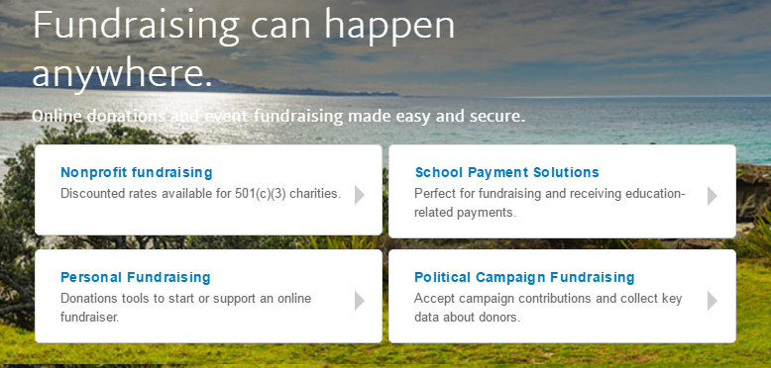
Go to Nonprofit fundraising
Your class needs to have an EIN under Dartmouth’s non-profit umbrella for this route (you should have one). This will enable you to get you lower fees for Class Dues payments, which are technically donations

Slide 5
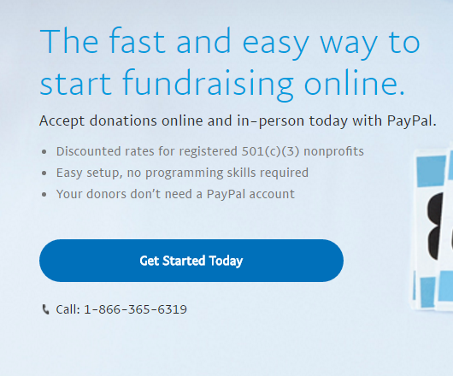
This brings you to a new page
https://www.paypal.com/us/webapps/mpp/donations
Click “Get Started Today”

Slide 6
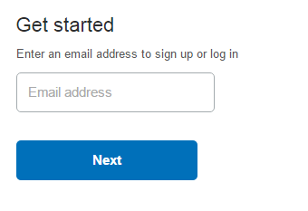
Add your email and click Next
It is STRONGLY recommended that you do not use a personal email address, as you will likely not be the treasurer forever. Lots of classes have a class Gmail/internet account that is shared among officers.
Click “Next”

Slide 7
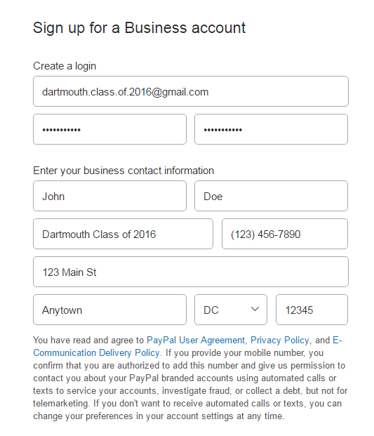
Create password, fill in your address
Create a password (write it down) and then fill in your contact information (personal information for the treasurer). The Business Name is “Dartmouth Class of XXXX”
Click on to the next page...

Slide 8
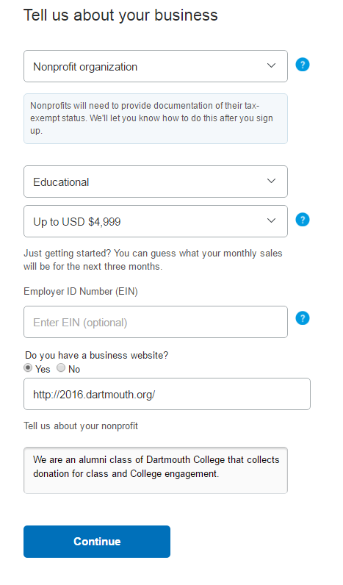
Add more information
Select Nonprofit organization
Educational
Up to $4,999 monthly sales
Add your EIN (you can add it later too)
Enter a class website if you have one
Fill in some information about your class (sample to the right)
Click “Continue”

Slide 9
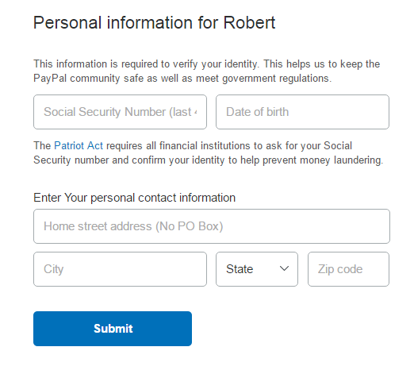
Confirm identity
You can change this information later but PayPal needs to tie all their accounts to a US citizen
This should be your contact information as treasurer
You need last 4 digits of your SSN and DOB
Click Submit

Slide 10
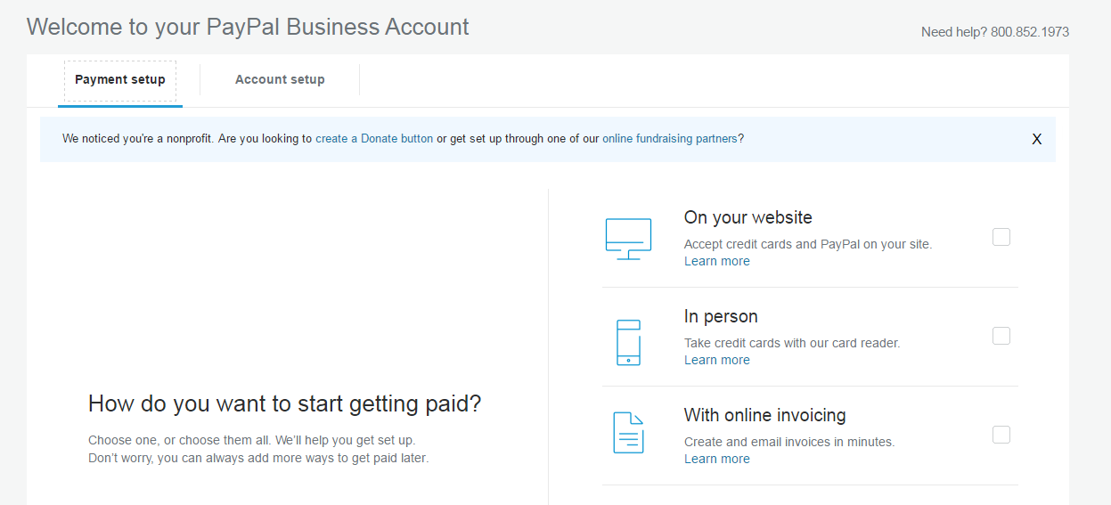
Success! Well, the beginning.
This should bring you to your Business Account welcome page.
Click Account Setup

Slide 11
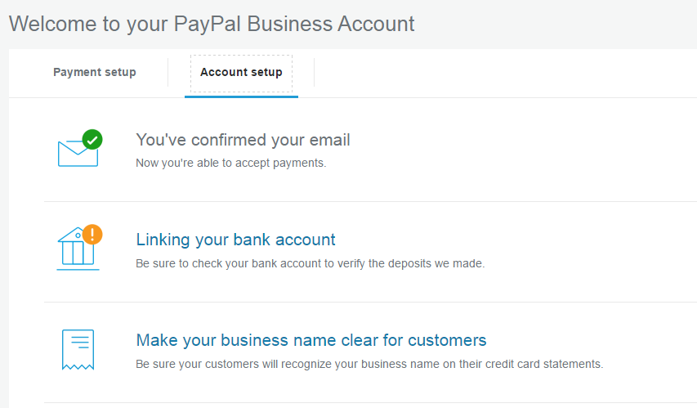
Confirm your email
The first step is to confirm your email address
Log in to the email address you provided and click the link in the email
You’ll have to enter your account password to verify it’s you
Now your email is confirmed

Slide 12
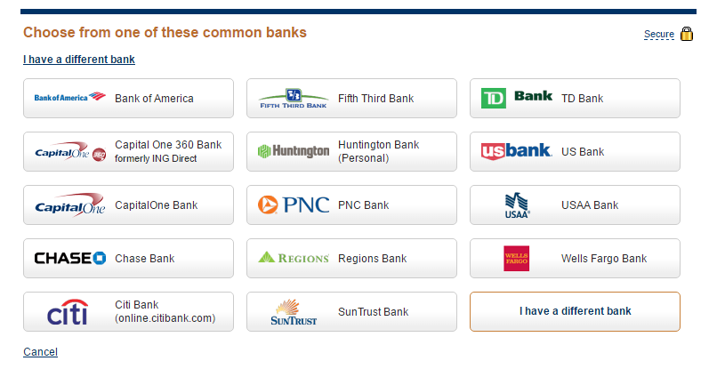
Verify your bank account
Click Linking your bank account on the Account Setup screen
On the next screen, select your bank
If you are a Ledyard treasurer, click “I have a different bank”

Slide 13
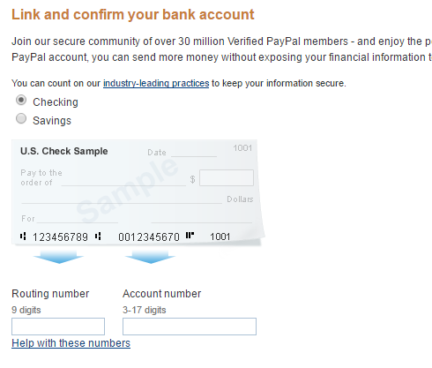
Fill in routing and account number
This is found on your bank account checks
Add the 9-digit routing number
Add the account number
If you don’t have a bank account yet, do that first and then come back to this step
This should be your CLASS bank account, never a personal account

Slide 14
Verification process
Once you hit submit, PayPal will send two small amounts (in cents) to your bank
This will take 2-3 days usually
Log into your bank account and find the amounts after 2-3 days
Then, log back in to PayPal and click “Linking your bank account” again
Press Confirm

Slide 15
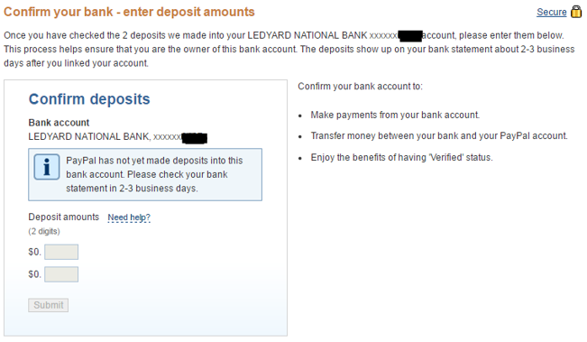
Verification process continued
Once you have received the amounts, type them in and press Submit

Slide 16
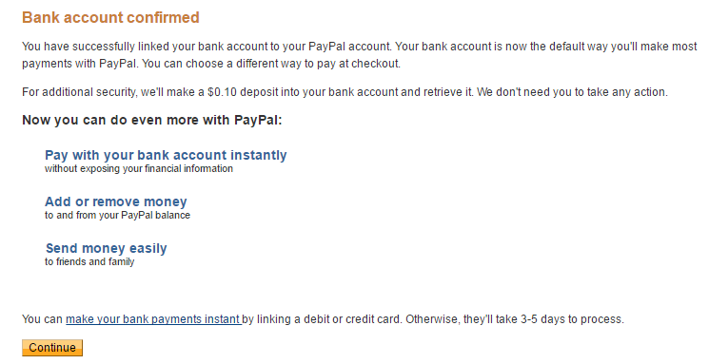
Verification process continued
Now your bank is confirmed, press Continue

Slide 17
Other details to confirm/add
At the top, click Tools, then Business Setup, then Account Setup

Slide 18
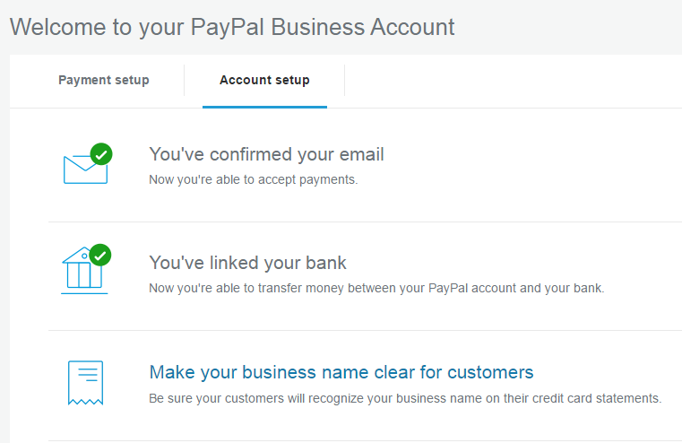
Make business name clear
Click third link

Slide 19
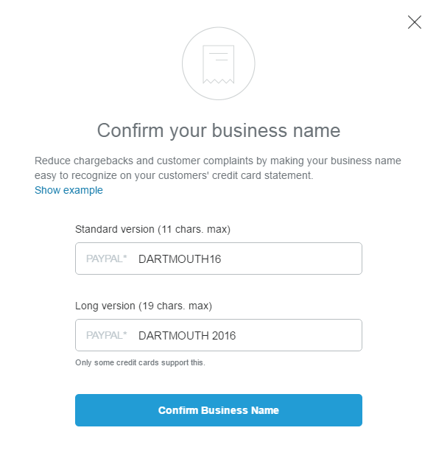
Make business name clear
Type in business names your classmates will recognize, such as:

Slide 20
Create Donate Button for website
Return to Business Setup (dropdown under Tools up top)
Click “create a Donate button” within the blue link

Slide 21
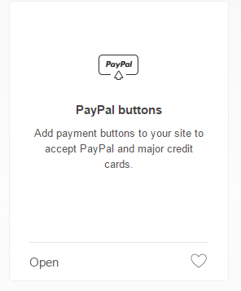
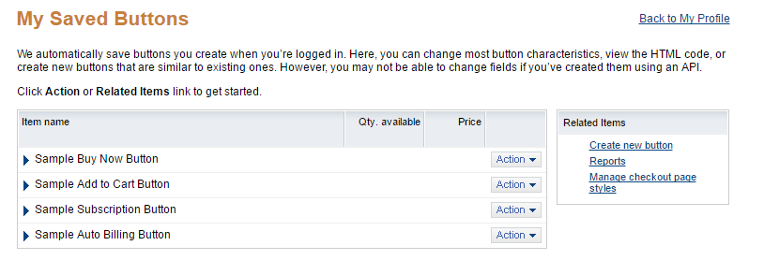
Create Donate Button, cont.
If that link doesn’t show up, you can also go to Tools, then All Tools, then after a couple clicks scroll down and click PayPal buttons →
Then click Create New Button on the right:

Slide 22
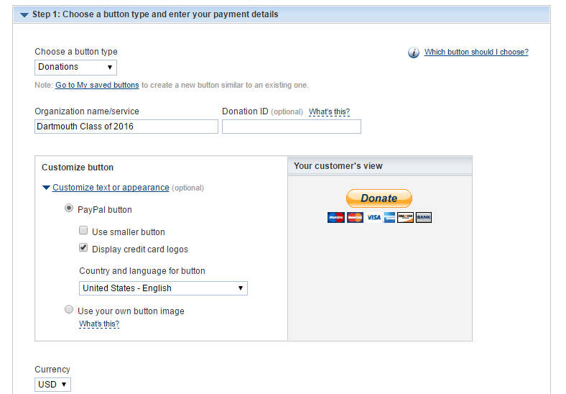
Create Donate Button, cont.
Fill in basic information
Donate button with credit card logos is my suggestion so classmates can pay with a PayPal account or credit/debit card

Slide 23
Create Donate Button, cont.
If dues are fixed, then choose Donors contribute a fixed amount
If classmates can choose amount OR if you have projects, then choose Donors enter their own contribution amount (suggested)
Use secure merchant ID

Slide 24
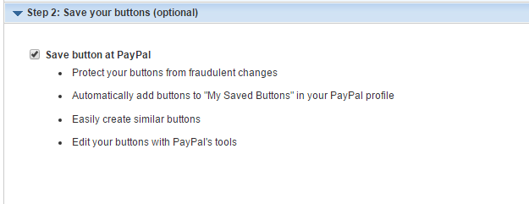
Create Donate Button, cont.
Save your button for the future

Slide 25
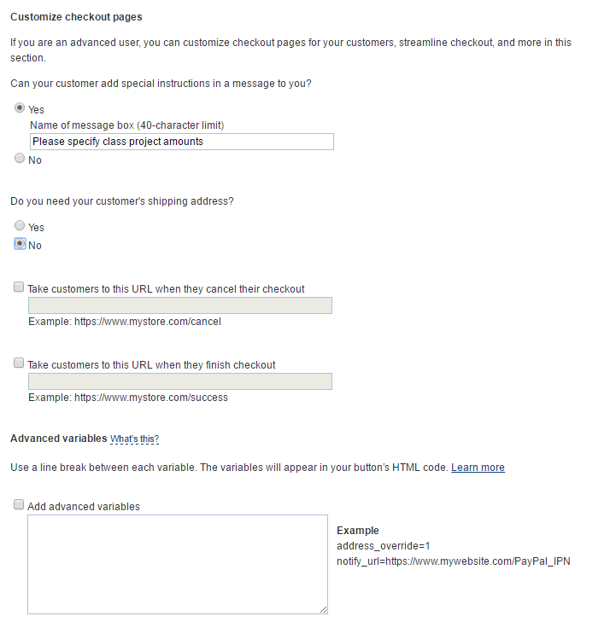
Create Donate Button, cont.
Add special features if you want
If you do have projects, you can add a special instructions box
No need for address
No need for cancelled checkout or thank you pages (unless you want to direct people to one)
Click Create Button once done

Slide 26
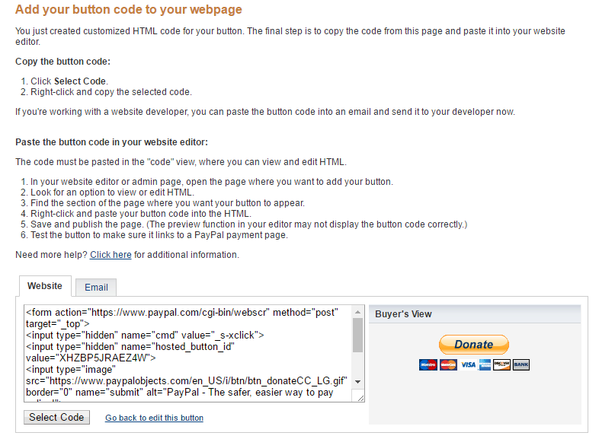
Use your Button
There are two ways to use your button, either in an email by using a custom URL link or embedding some code on a webpage like your class website

Slide 27
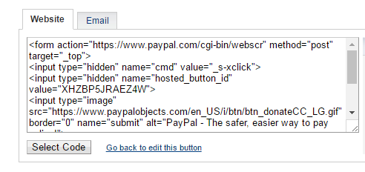
How to put the button on your class website
If you’re a little tech savvy, you can probably do this...
Log in to your website (you need login credentials granted through Alumni Relations), then go to the desired page, switch to HTML mode and copy the code in
Or ask your webmaster or the College for help

Slide 28
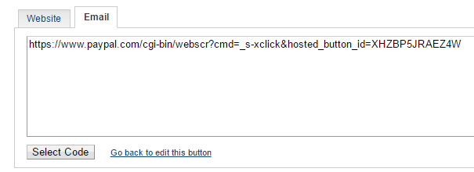
How to put a link in an email
If you are sending a class dues email solicitation, you can insert a hyperlink within the email
The link can go to your class webpage or directly to PayPal
Just insert a text link (Pay Class Dues) and use the permanent custom URL shown under Email as the hyperlink to direct your classmates to:

Slide 29
Now you can get paid!
You should be able to accept class dues payment through your classmates, either by a button on your website or through email
You can transfer money from PayPal to your bank account whenever you want
You can send people money electronically from PayPal (even if you don’t have a balance), this is great for reimbursement
PayPal also has tools to refund payments quickly
Sample class dues page on how I have set up the button and other information about dues: http://2008.dartmouth.org/s/1353/clubs-classes-interior.aspx?sid=1353&gid=342&pgid=4770

Slide 30
Testing it out
I would recommend testing out the payment system yourself before emailing out a link to the class or directing folks to your class website
You can go through the payment process and see if there is anything confusing (and then edit the button or web page accordingly if needed)
Once you pay dues, the email account for your PayPal account will get an email confirmation and so will the dues payer

Slide 31
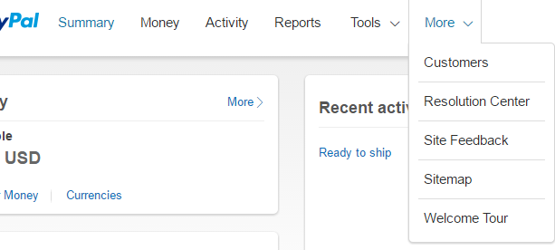
PayPal resources - FYI
PayPal has a lot of resources if you have questions about how to use the site (see Help at the bottom)
I would recommend going to More up top and then clicking Welcome Tour if you’re pretty new to PayPal

Slide 32
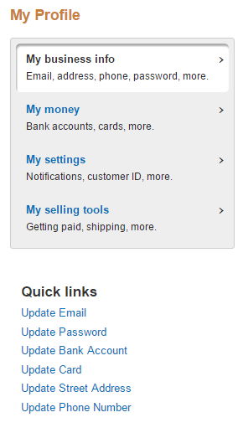
Updating preferences - FYI
If you want to edit anything, click Profile in the upper right and then “Profile and Settings”
Under “My business info” is where you can add your Class EIN, update your SSN if you have a treasurer change, and update contact information
Under “My money” is where you can update bank account and look at monthly statements
Under “My settings” is where you can add users to the account and adjust email notifications (I would unsubscribe from Offers and News and updates)
Under “My selling tools” is where you can edit your Buttons and do fancy stuff (mostly not necessary)
Under those 4 links are Quick Links for the most common changes

Slide 33
Congrats!
You should be all set with a confirmed bank account, confirmed email address and buttons/links to be able to receive payments from your classmates
Since you registered as a nonprofit, you should have lower fees than a normal business (nonprofits get 2.2% + .30 per transaction)

