Slide 1
Introduction to QuickBase
01/2023

Slide 2
The Big Picture
Review of the HOME page
  Key links
Edit Dues Questionnaire
  The key administrative page
Review of key tabs
  Alumni
  Payments
    Sharing a report
  Classes
Logging a payment

Slide 3
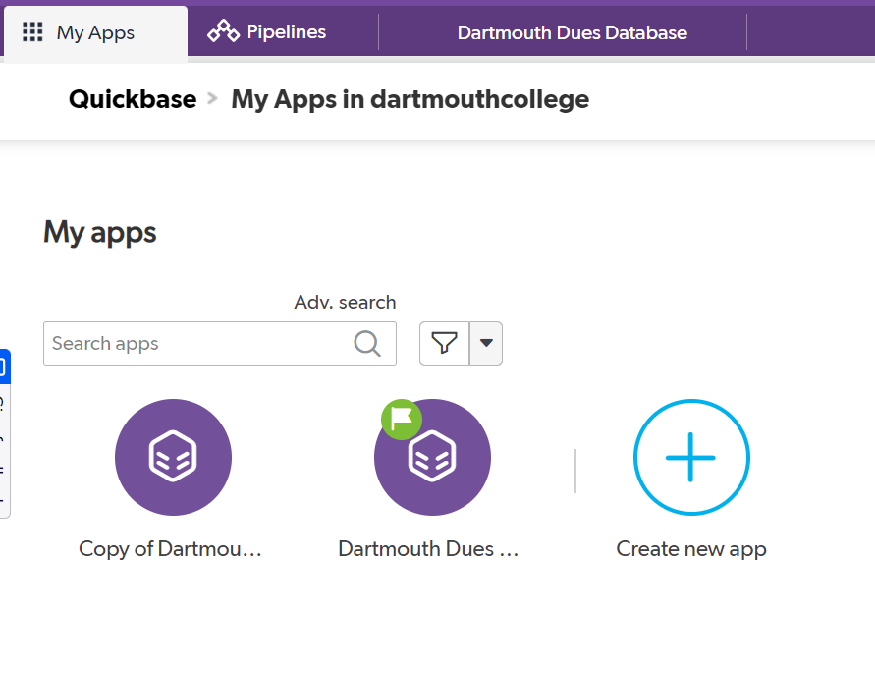
Home Page
Either click on the app names “Dartmouth Dues Database” or on the tab located in the upper light side.

Slide 4
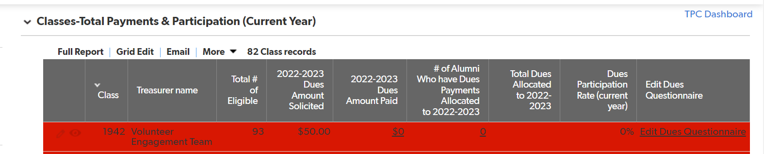
Home Page – continued
The table below shows you current year payments
Total # eligible = all alumni on active mailing list and not asked to be excluded, updated bi-weekly
Key administrative section

Slide 5
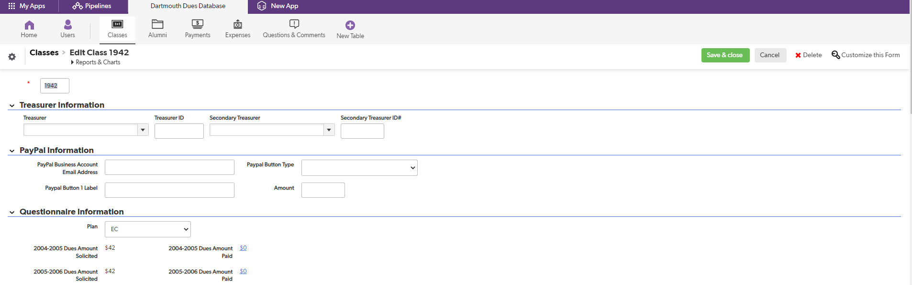
Edit Dues Questionnaire
What it is: administration of dues, projects, personal info, quarterly dues mailings
Note: Ignore Secondary Treasurer, no longer active
*Key* item to remember: Save all changes
Set your dues amount in this section

Slide 6
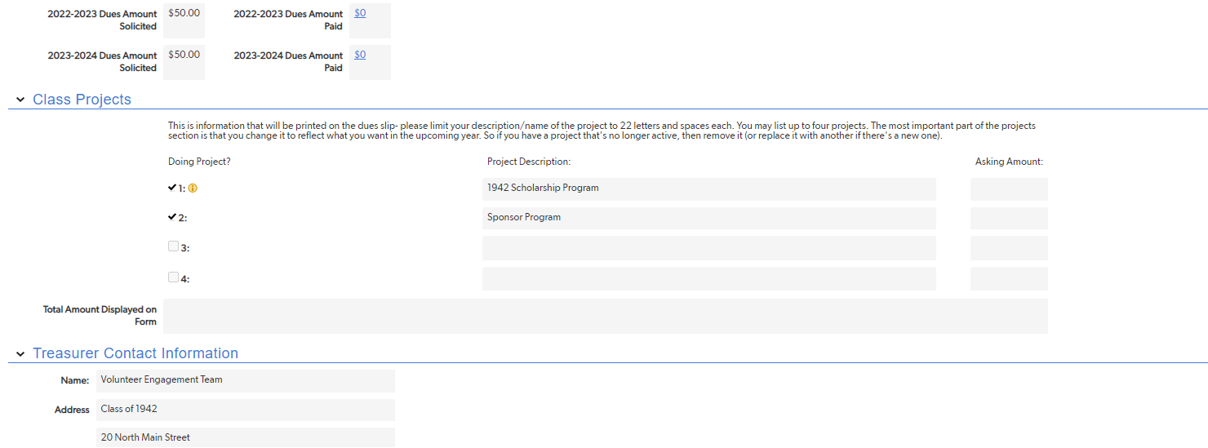
Edit Dues Questionnaire, Continued
List your class projects here
Can set an amount for projects or leave blank
DO NOT FORGET to click on Save button at top right of page for all changes!!!

Slide 7
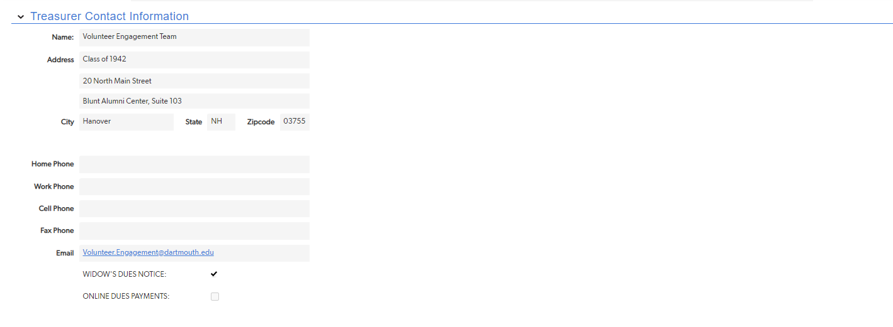
Edit Dues Questionnaire, Continued
Fill in your personal information here
DO NOT FORGET to click on Save button at top right of page for all changes!!!

Slide 8
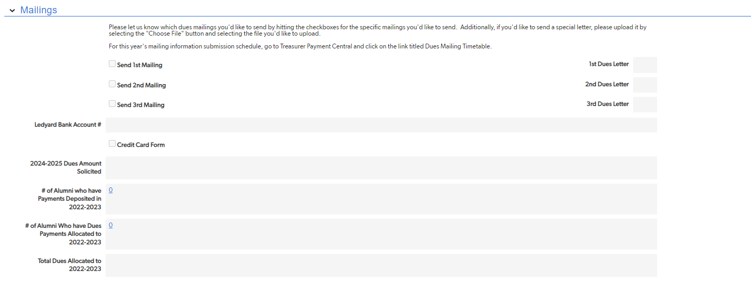
Edit Dues Questionnaire, Continued
For snail mail dues mailings
--Select mailings you wish to participate in.
Schedule of mailing deadlines is on treasurers website
Upload your snail mail dues requests letters here by clicking on “CHOOSE FILE”
Upload letters in Word
Sample letters are on the treasurers website

Slide 9
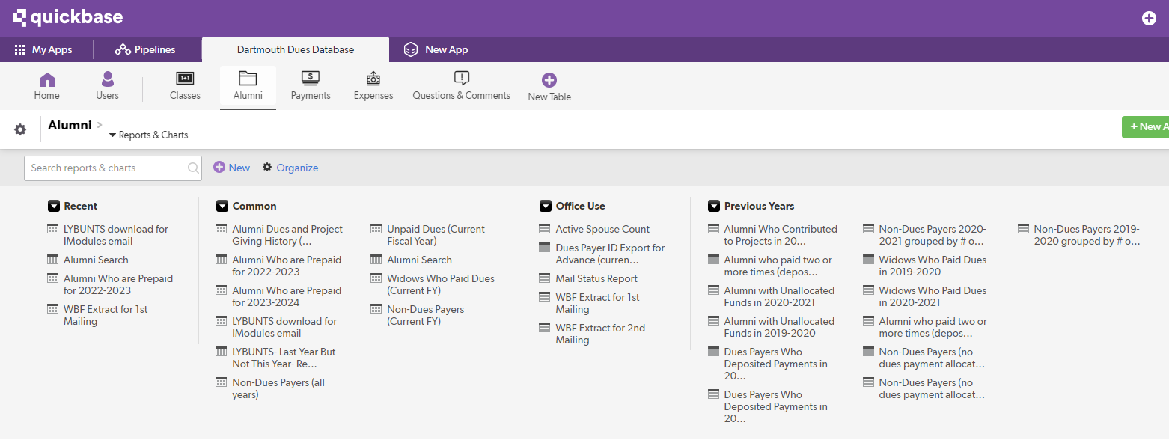
Key Tabs: Alumni
Use for biographical reports and searches
Prepaid dues can be carried two years forward only (in QuickBase)
Alumni who paid 2 or more times
  Set a strategy
Go look at the reports!

Slide 10
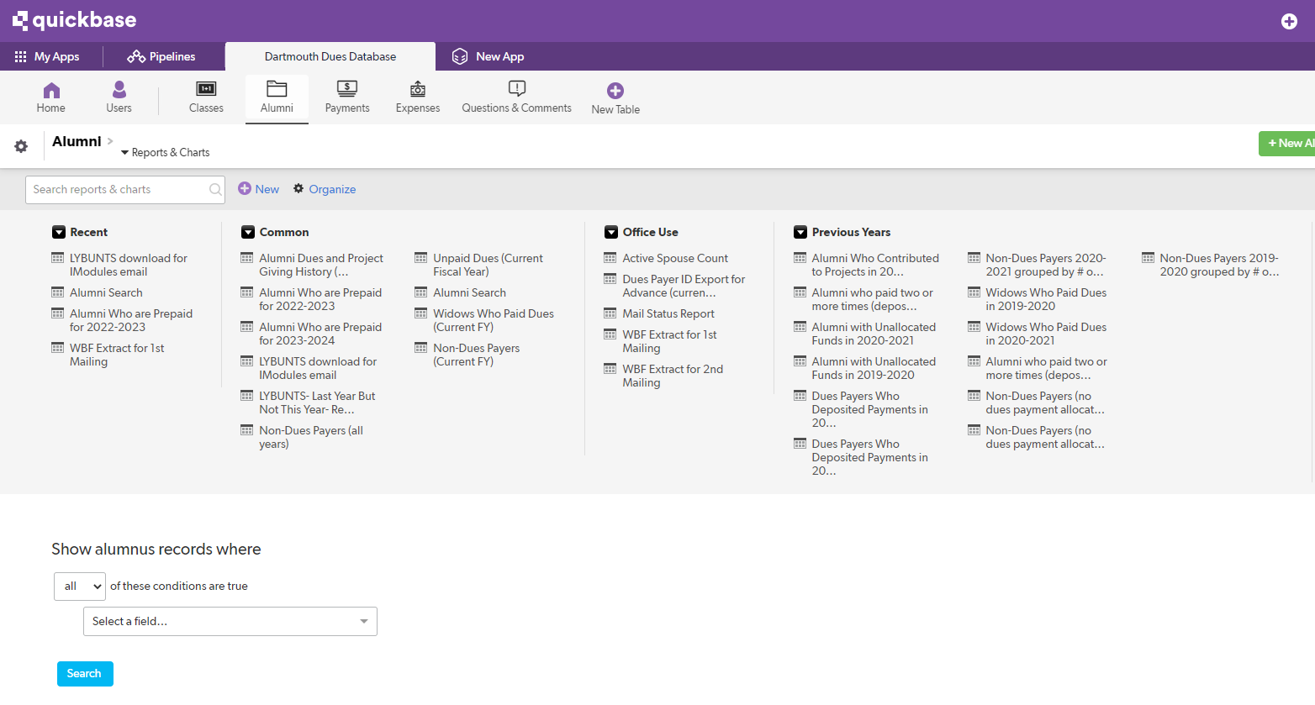
Key Tabs: Alumni, Continued
Common vs. personal reports
  Common are universal
  Personal are YOUR reports you create
LYBUNTS (last year but not this year)
Two LYBUNTS reports, top one is for exporting for email requests (description in gray)
Go look at the reports!
Powerful “biographical” search engine
Pick any informational element (e.g. names, zip codes, etc.)
Can take this data and turn into a personal report (e.g. all classmates in Texas, or all in Hanover) for targeted groups; will update over time
Can be used for Paypal payments that don’t identify by name; use the Paypal address info to find alum’s name

Slide 11
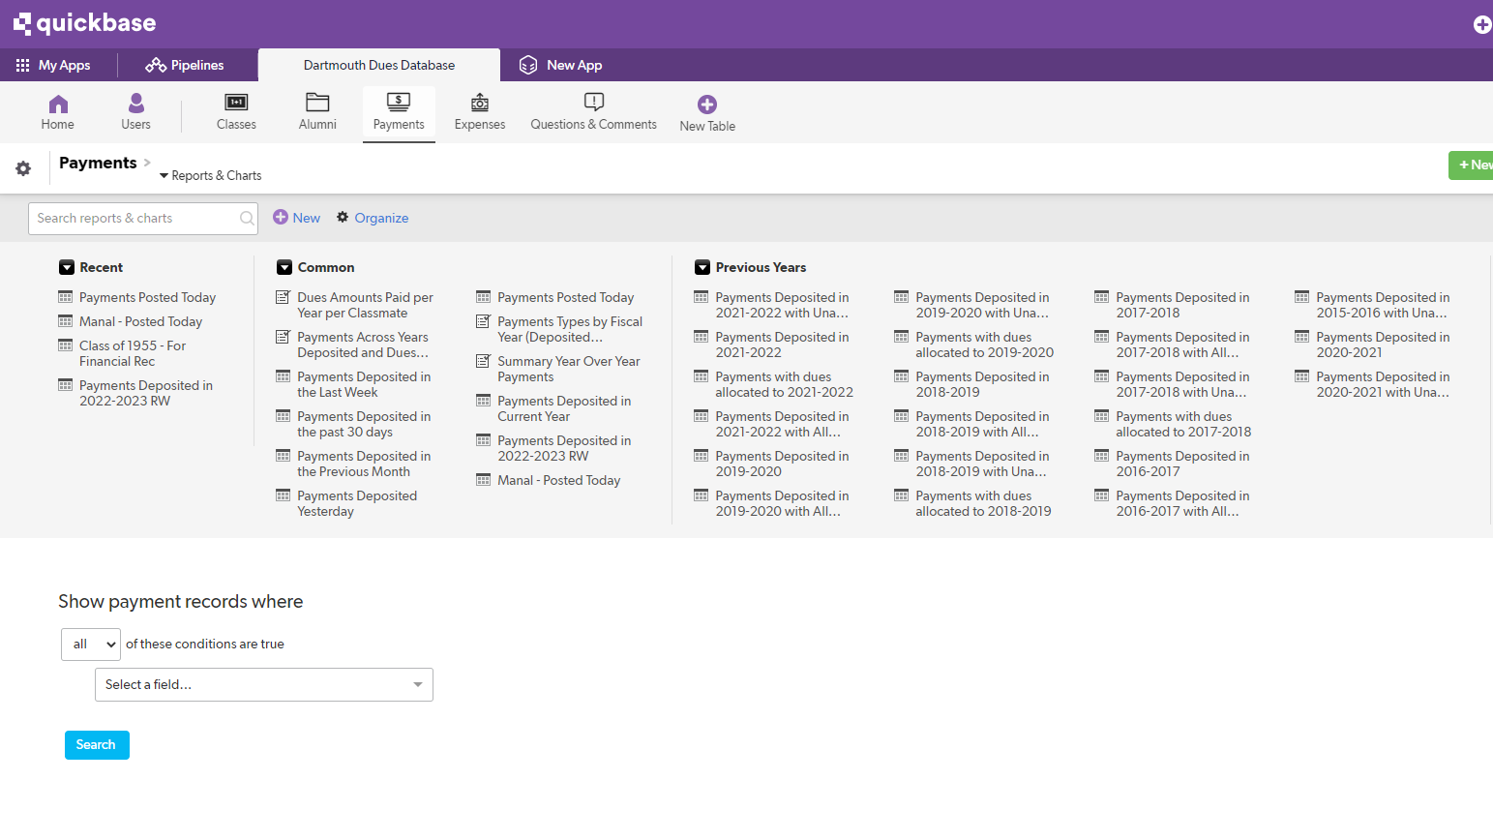
Key Tabs: Payments
Common vs. personal reports
  Has current and prior year payments
Key report: Payments Deposited in the Previous Month
  For Ledyard reconciliation
  Back out Paypal/direct checks to you
  Note for Wheelock treasurers: checks you input in QB after month end after depositing into the bank during the month end won’t reconcile
Powerful “payments” search engine
Can do personal reports here as well
Can add multiple search terms (go to far right (not visible here): you can ADD, DELETE and use OR (blue arrow) for your payment searches

Slide 12
Sharing a Report
You only have credentials for one person, the treasurer
You can share reports by converting and exporting them into Excel/CSV.

Slide 13
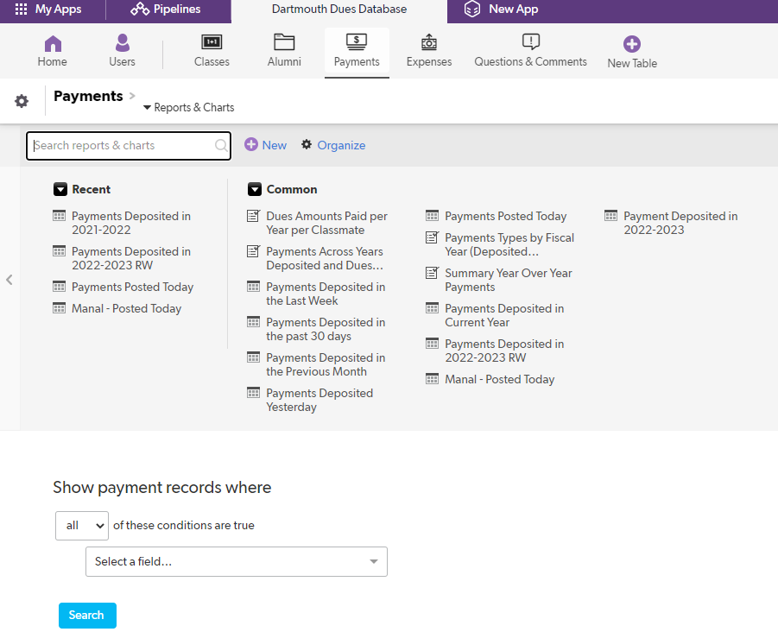
Sharing a Report, Continued
Example
Go to Payments tab
Select a report (here, payments deposited in 2022-2023

Slide 14
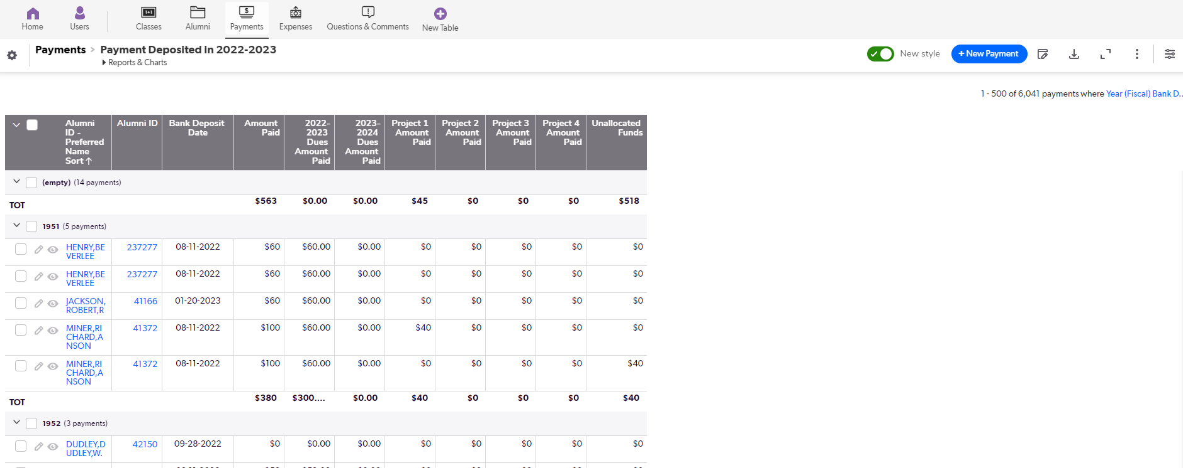
Sharing a Report, Continued
Report will be generated
Click on the circled icon to download

Slide 15
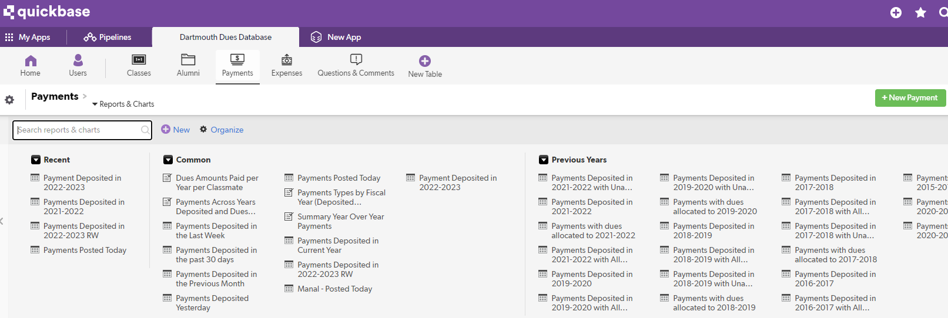
Logging a Payment
Use this for recording individual payments
Go to the Payments tab
Click on the green New Payment button

Slide 16
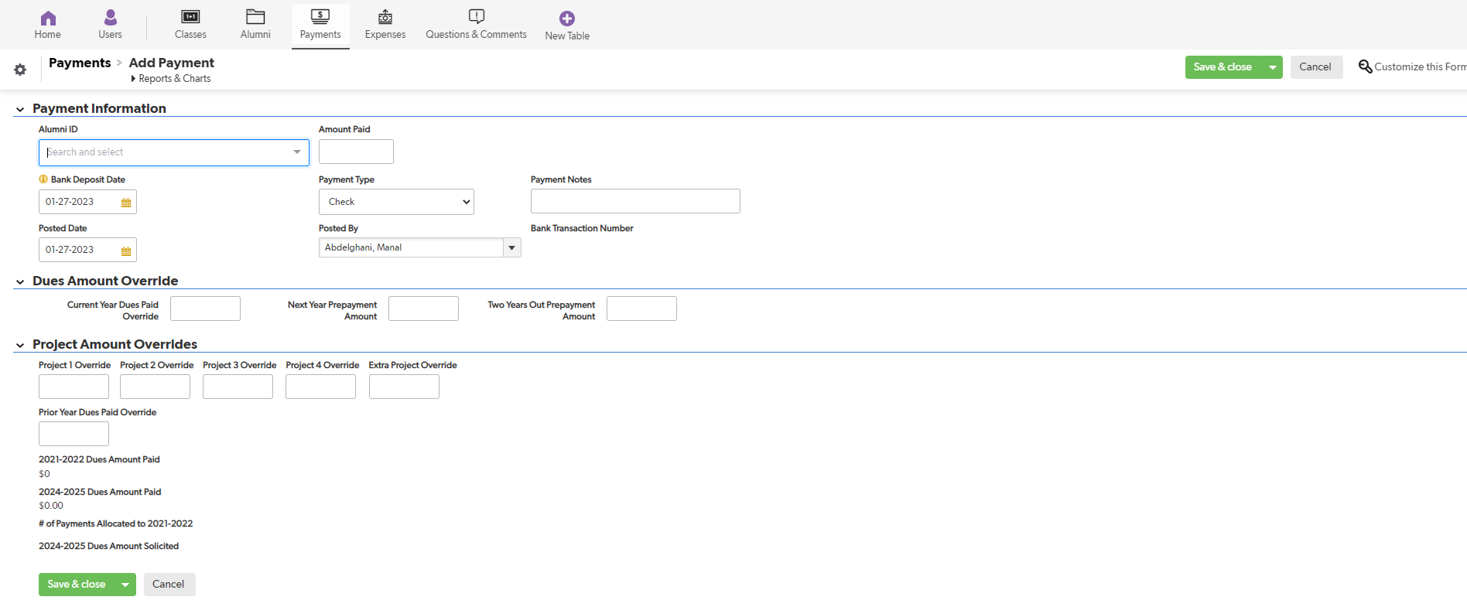
Logging a Payment, Continued
Use the drop down box under Alumni ID to select the name of the paying classmate
Enter the Amount Paid (total)
Dues Amount Override can be used to allocate multiple dues payments by one person in a year OR prepayments of dues
  Set the $ amount in each box where you want the payment allocated
Project Amount Override can be used to allocate a payment to a specific project
DO NOT FORGET to click on Save button at top right of page for all changes!!!

Slide 17
Thank you!

