Slide 1
Dartmouth Club and Group Officer Weekend Admissions Ambassador Program Overview January 21, 2017
Meg Lysy ’99, Director
Jenn Calver, Assistant Director
Aubrey Mignone, Program Coordinator
Deb Melvin, Admissions Office Liaison to the AAP
Will Corbett, Senior Assistant Director of Admissions

Slide 2
The Admissions Ambassador Program
Admissions Ambassador Program
Recruitment
Interviews
Yield
Relationships
Notes:
Will

Slide 3
5,003 “Active” Admissions Ambassadors
# of Alumni Interviewers
Class Year
Notes:
Meg

Slide 4
242 District Enrollment Directors (DEDs)
DED Graduation Year
# DEDs
Class Year
Notes:
Meg

Slide 5
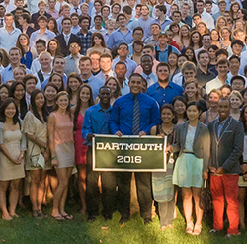
Virtual District
# Interviewers
Notes:
Will

Slide 6
Interview Completion
Notes:
Will or Meg

Slide 7
Class of 2021 – Early Decision Only
Applicants with a Submitted Interview Report
Early Decision AAP Stats
Applications: 1,999
Interviews Assigned: 1,920
Reports Submitted: 1,821
Last year ED, 85% of applicants had an interview report submitted.

Slide 8
Admitted Student Events (ASEs)
APRIL 2017

Slide 9
Admitted Student Events (April 2016)

Slide 10
Admitted Student Events

Slide 11
Looking Ahead
DED nominations for excellent interviewers
Senior Week and YADA collaboration
Slate enhancements
Regional Trainings

Slide 12
Slate Alumni Portal
Slate Login

