Slide 1
RISK MANAGEMENT FOR DARTMOUTH ALUMNI CLASSES

Slide 2
Outline
Exposures at Class Events
Managing the Exposures
Certificates of Insurance
Contracts
Alumni Organizations Insurance Policies
Directors & Officers Coverage

Slide 3
Activities associated with Alumni Classes
Special Events/ Class Events :
Class Meetings:
Luncheons, evening gatherings &annual meetings
Reunions:
Major Reunions, Mini Reunions &Homecoming

Slide 4
Exposures at Alumni Class Special Events
Accidents & Injuries at the event.
Incidents at events where Alcohol is served.

Slide 5
Managing the Exposures
Accidents & Injuries at the event
When selecting a location for your event make sure there is adequate lighting, railings on all stairways. Beware of uneven ground.
Conduct a pre-site inspection.
Provide adequate trash receptacles to keep debris off the ground
Stay alert throughout the event – If something spills or breaks immediately clean and section off the area.
Obtain a certificate of insurance from all service providers. Ensure that your Class is added to the providers insurance policy as an additional insured. (tent co.’s, entertainers, caterers etc.)

Slide 6
Managing the Exposures
Events with Alcohol
Comply with all local, state and federal laws and regulations pertaining to the serving of alcoholic beverages.
Do not serve alcoholic beverages at a class event in a facility that does not itself have a liquor license or permit unless you have either:
Verified with your state’s authorities that a liquor license or permit is not required; or
You have hired a caterer or bartender with the required liquor license or permit.
If you are hosting a class event where alcohol is served in a private home we recommend that you hire a licensed bartender or caterer with liquor liability insurance to serve the alcohol and obtain a certificate of insurance.
Provide safe transportation
Include food service and non-alcoholic beverages at all events where alcohol is being served

Slide 7
Certificates of Insurance
All contractors, vendors or service providers should have their own insurance.
(Minimum $1,000,000, per occurrence, General Liability Coverage)
Your Class should be named as an Additional Insured on service providers certificate of insurance.
Reference - Risk and Internal Controls – Insurance Compliance and Certificates of insurance.
http://www.dartmouth.edu/~rmi/rmsinsurance/compliance.html

Slide 8
Sample – Certificate of Insurance

Slide 9
Contracts
Contract should be signed and authorized in the name of the alumni class versus an individual.
Thoroughly review the indemnification section & insurance requirements – Any questions – Please call !

Slide 10
INSURANCE
The College purchases a General Liability and Umbrella policy for all RECOGNIZED Alumni Organizations.
These policies protect Alumni Organizations from claims for bodily injury, third party property damage and personal and advertising injury arising out of Alumni Organization activities.
Their combined limit of liability is:
$2,000,000 per occurrence / $3,000,000 aggregate
Liability coverage applies to All Alumni Organization related activities ON campus and OFF campus.

Slide 11
Who is Insured
Members
Volunteers
Elected and Appointed Officers
BUT – Only while acting within your scope of duties on behalf of your Alumni Class Organization.

Slide 12
IMPORTANT
EXCLUSIONS

Slide 13
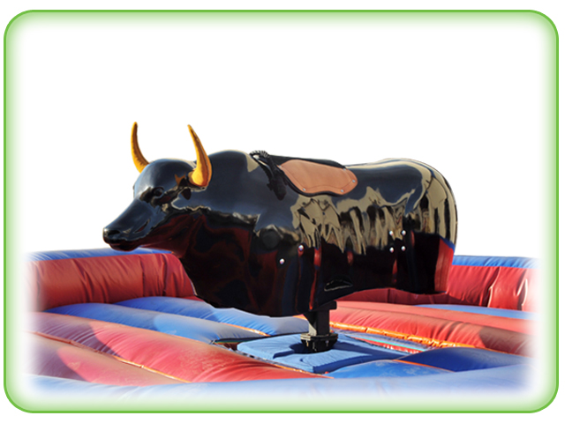
MECHANICALLY OPERATED AMUSEMENT DEVICES
EXCLUDED

Slide 14
Aircraft, including balloons, tethered balloons & parachuting. EXCLUDED

Slide 15
Fireworks, pyrotechnics
EXCLUDED

Slide 16
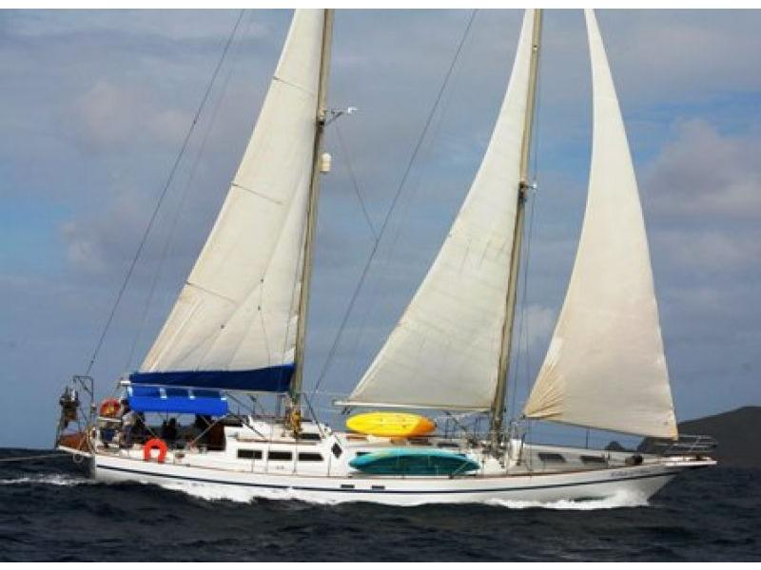
Non-Owned watercraft over 50 feet
EXCLUDED

Slide 17
The College purchases a Commercial Crime policy specifically for Dartmouth College Alumni Classes
Crime coverage protects your Alumni Class Organization from losses resulting from criminal acts that could cause major financial setbacks.
The limit of Liability is $100,000
The crime policy provides several different types of crime coverage; employee dishonesty (incl. non-compensated officers as employees), forgery or alteration, computer fraud and funds transfer fraud.

Slide 18
How to access information regarding INSURANCE
Go to Dartmouth Alumni’s Home Page:
http://alumni.dartmouth.edu/
Click on CLASSES

Slide 19
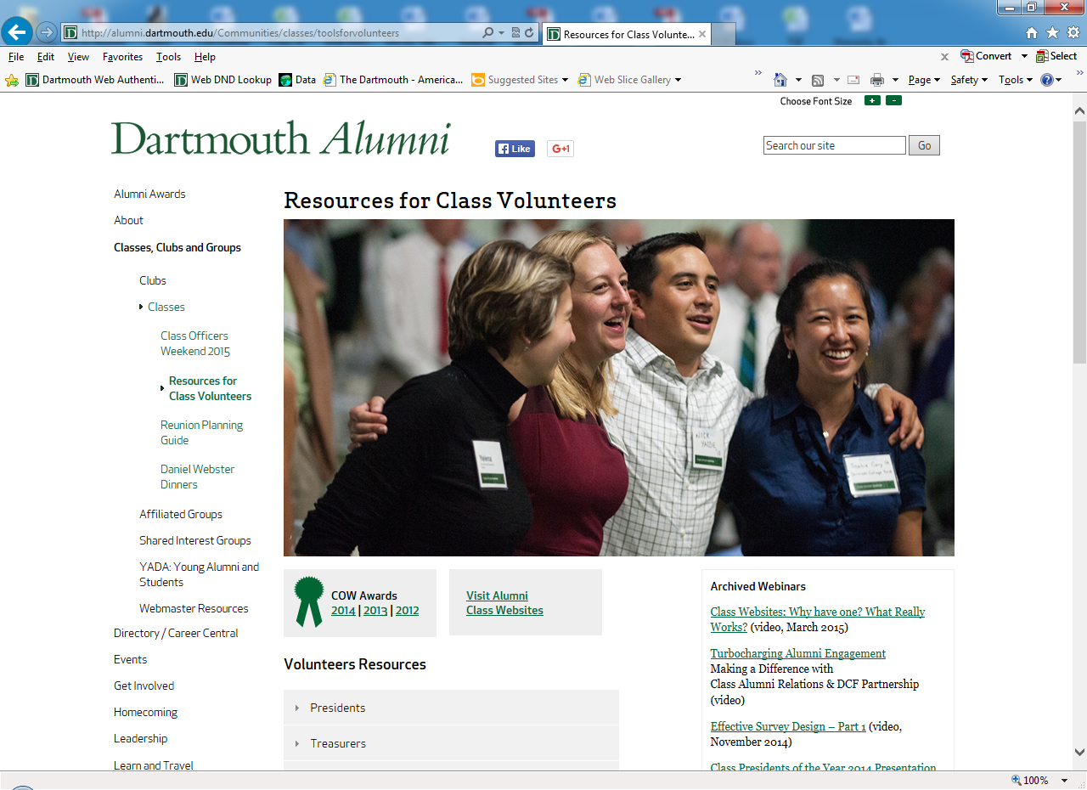

Slide 20
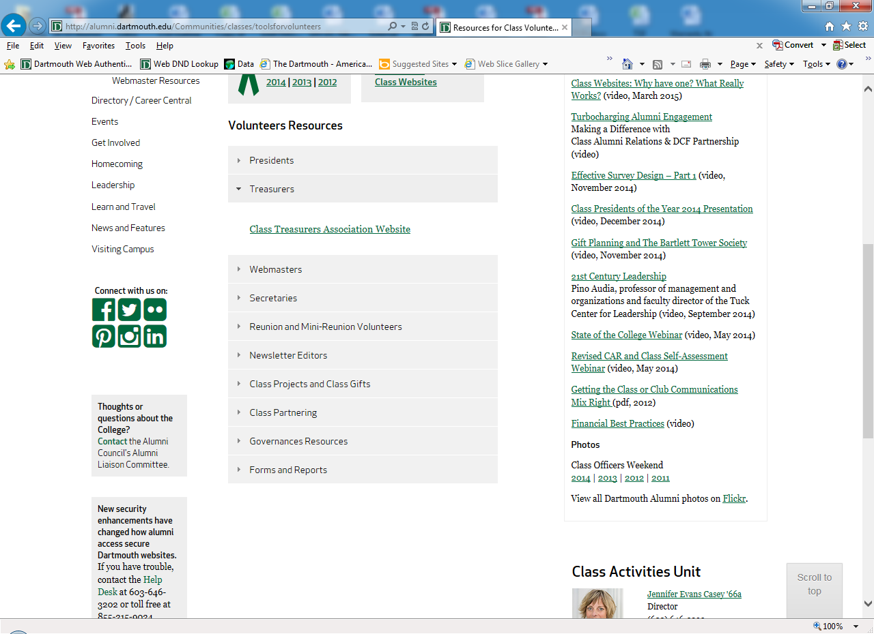

Slide 21
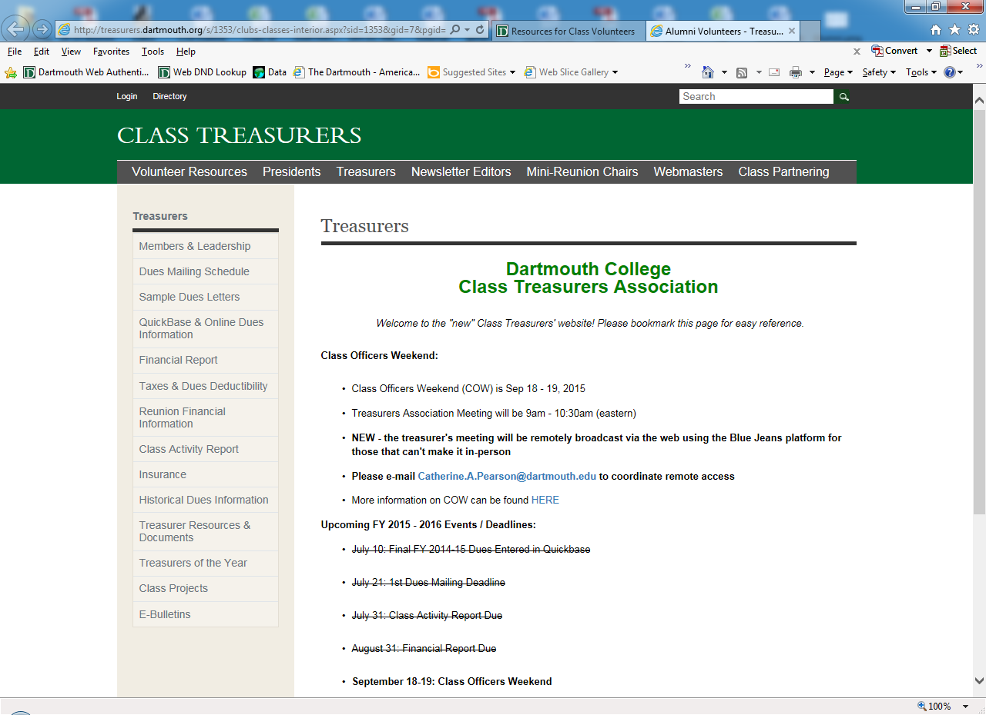

Slide 22
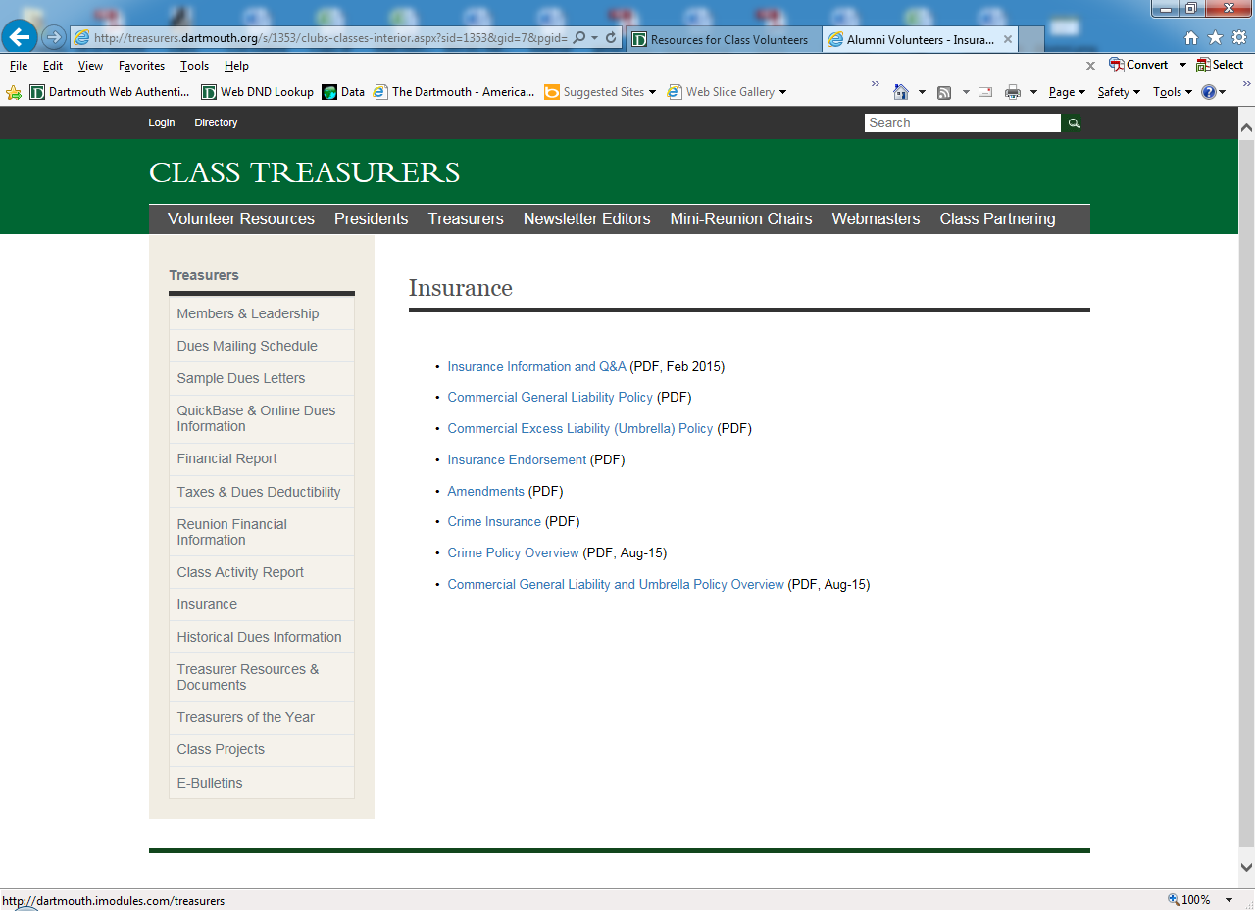

Slide 23
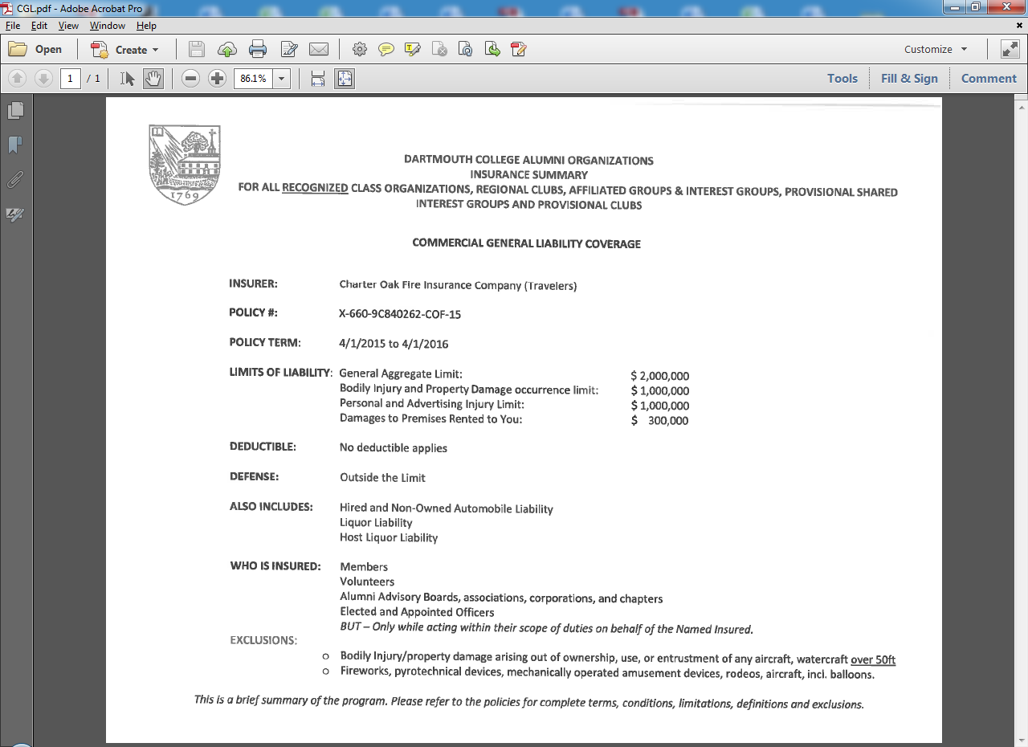

Slide 24
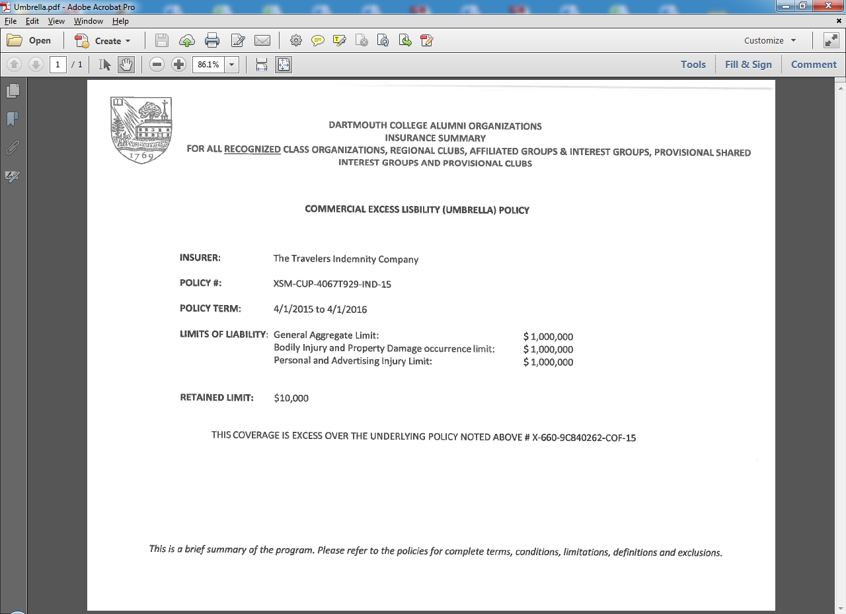

Slide 25
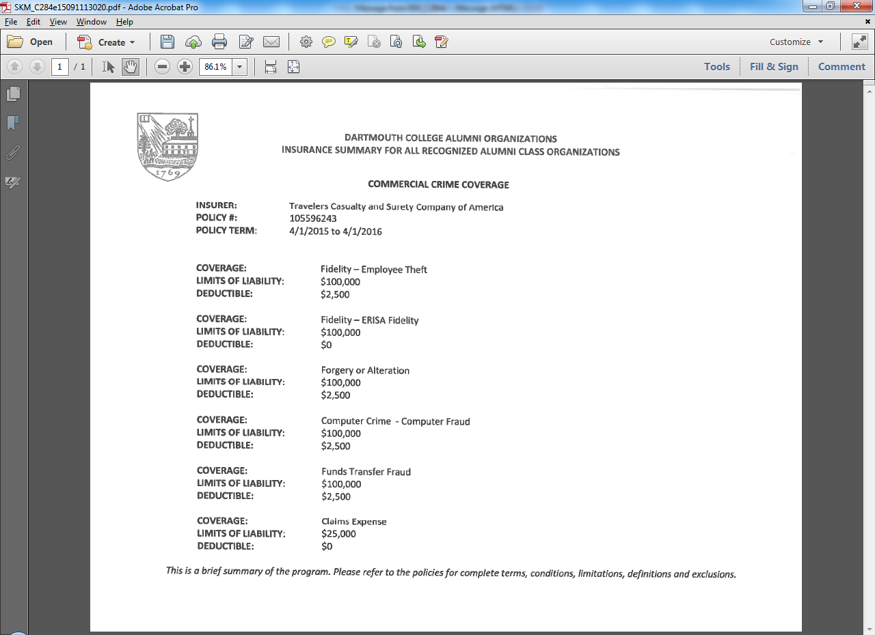

Slide 26
Directors & Officers Coverage
The Alumni Organizations Liability Policies do not include Directors & Officers Coverage.
We recommend that each Class purchase Directors and Officers Coverage.
Directors and Officers Coverage provides financial protection for Insured Persons against the consequences of actual or alleged “wrongful acts”.

Slide 27
QUESTIONS!

Slide 28
CONTACT INFORMATION Tina Feeney Insurance and Loss Control Manager Tina.Feeney@Dartmouth.edu 603-646-9257

