Slide 1
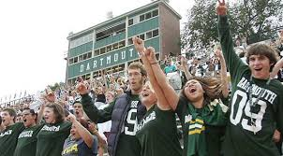
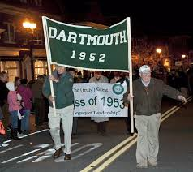
Momentum & Activity
How Partnership between
Class Alumni Relations & DCF Makes a Big Difference
September 19, 2015

Slide 2
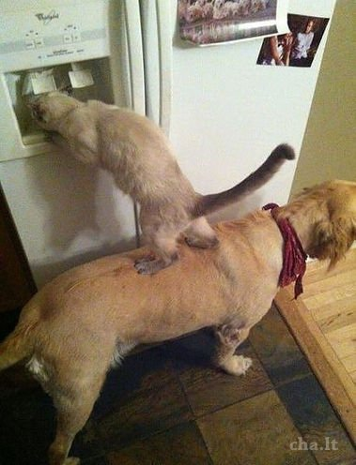
Today’s Discussion
Why Partner?
Best Practices for Partnering:
General
Reunion
Ways of Facilitating Partnering
Your Suggestions and Questions

Slide 3
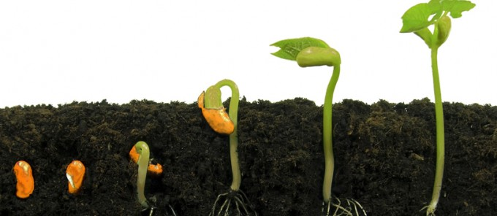
Cross-Cultivating: Cathy Judd-Stein ’82
“To the extent we encounter disappointed alums and classmates, I believe strongly in the strength of the community that we all work to nurture. I have witnessed classmates, who vowed never to give to DCF again, rally to help a classmate in need and through a different path paved by class unity make their way back to the institution of the College.
The College and volunteer infrastructure for both Alumni Relations and the DCF is so valuable and unique -- it is not part of the alumni cultivation of other colleges and universities. At times like this, it is indeed critical.”
3

Slide 4
Why Partner?
Coordinated Efforts between DCF and Class Activities Enhance (Rather than Cannibalize) College Support
Create a Virtuous Cycle of Engagement:
Attend/Read Dartmouth and/or class event
Donate $ to DCF
Donate Time to Class /
College
Attend/Read more Dartmouth and/or class events
Donate more $ and time
4

Slide 5
Best Practices: General
Tip #1: If Not Already Doing So, Meetings and Calls Should Include Head Agents:
Gives both sides broader perspective of what each team is doing – and when
Benefits brainstorming with building on other’s ideas
More volunteers involved = broader reach of class
DCF volunteers are in direct contact with classmates:
Can provide fodder for newsletters, DAM column
Identify obsolete / stale contact info
5

Slide 6
Best Practices: General
Tip #2: Make Giving Fun!! Use Prizes to Incentivize Donating to Both DCF and Dues:
Donate to DCF and Dues and Classmate Could Win 1 of X # of Prizes:
Class sweaters, Co-Op gift cards, D schwag
Items donated by classmates
Joint communications help clarify difference between DCF and dues
Do the Promotion Leading Up to a Big Event (Homecoming, Winter Carnival, Green Key):
Or up to 91st day of year (for class of ’91)
Make a gift to DCF and pay dues during the 4 weeks before Green Key and your name will be entered into a prize drawing!
6

Slide 7
Best Practices: General
Tip #3: Incorporate DCF into Class-Wide Communications:
Let DCF Have the Stage at Key Times
year-end push, promotions
DCF in Newsletters 2x/year
goals and outcomes – builds class pride with accomplishments
special promotions
DCF Judiciously in Social Media
Final stretch of fiscal year
7

Slide 8
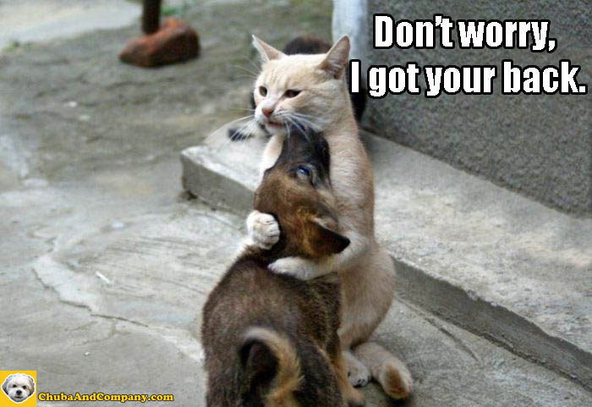
Tips and Best Practices: General
Tip #4: President and Other Class Leaders Assist as DCF Volunteers:
Help Identify & Recruit Volunteer Agents
Do outreach to disengaged classmates and lapsed donors
Feature in newsletters, DAM, etc.
Personal calls to attend mini-reunions
8

Slide 9
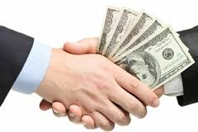
Best Practices: General
Tip #5: Lead by Example
DCF Volunteers:
Pay Class Cues
Attend Mini-Reunions/Class Events
Class Officers:
Give Annually to DCF
And 1769 Society where Appropriate
9

Slide 10
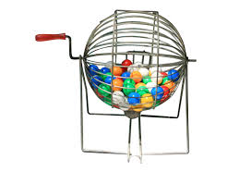
Best Practices: Major Reunions
Tip #1: Cross Sell
DCF Volunteers:
Promote Reunion Attendance
Reunion Volunteers:
Promote DCF Giving
Tip #2: Integrate to Underscore Connection Between Class Activities and DCF:
Give to the DCF and win a chance to attend Reunion for free!
10

Slide 11
Facilitating Partnering
#1: Sort Out All Giving Opportunities:
Be Exquisitely Clear About Each of the Roles of Class Dues, Class Projects and DCF
#2: Ensure Class Activities Don’t Undermine DCF Goals – and Vice Versa:
Coordinate. Be selective and strategic about whom you target for bigger $$
Raising $ for class projects should not not cannibalize DCF efforts

Slide 12
Facilitating Partnering
#3: Rebrand Dues:
Call it “sponsoring class activities” instead of paying dues
#4: Target Classmates:
Focus on people who donate to DCF but not to class dues (and vice versa)
Target classmates geographically by promoting local D events that don’t involve asking for $$:
Dartmouth on Location, President Hanlon tours, etc.

Slide 13
Suggestions and Questions
Questions/Your Best Partnering Ideas…
13

Slide 14
We’re Here To Help. We’d Love to Hear from you!
Head Agents:
Bruce Miller ‘74: brucedalemiller@yahoo.com
Ammar Khalid ‘01: ammar.khalid@wellsfargo.com
Class Presidents:
Catherine Craighead Briggs ’88: briggszoo@gmail.com
Cathy Judd-Stein ’82: cjuddstein@gmail.com
John Valdez ’07: valdez.john.e@gmail.com
14

