Slide 1
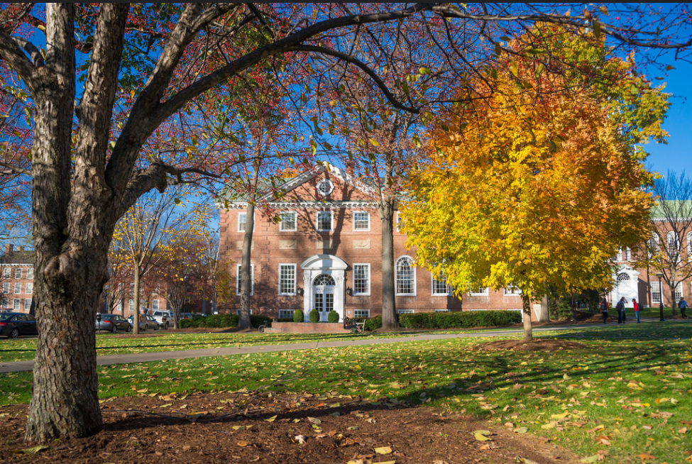
Association of Gift Planning Chairs Annual Meeting
Welcome to the
2015 Class Officers Weekend

Slide 2
Gift Planning Office Staff
Susan Hanifin
Executive Director
Heather Ermarth
Associate Director
Darius Long
Life Income Plan Manager
Margo LaHaye
Assistant Director
Julie Hinman
Volunteer Program Manager
Kristen Campbell
Gift Planning Assistant
Notes:
Nancy to call meeting to order
Introduce staff – pointing out new employee Heather and
Julie’s promotion

Slide 3
New Gift Planning Chairs
Class of 1965
William O. Webster, Jr.
Class of 1979
George S. Stone
Class of 1982
Albert E. Dotson, Jr.
Sarah (Sally) Gaines McCoy
Ralph McDevitt III
Notes:
Nancy to introduce, refer to detailed bios in folder; also note the passing of Bill Hale ‘44
Approval of 2014 Minutes which received with Quarterly Newsletter

Slide 4
We Remember
Class of 1944
William B. Hale
Gift Planning Chair 2007 - 2015

Slide 5
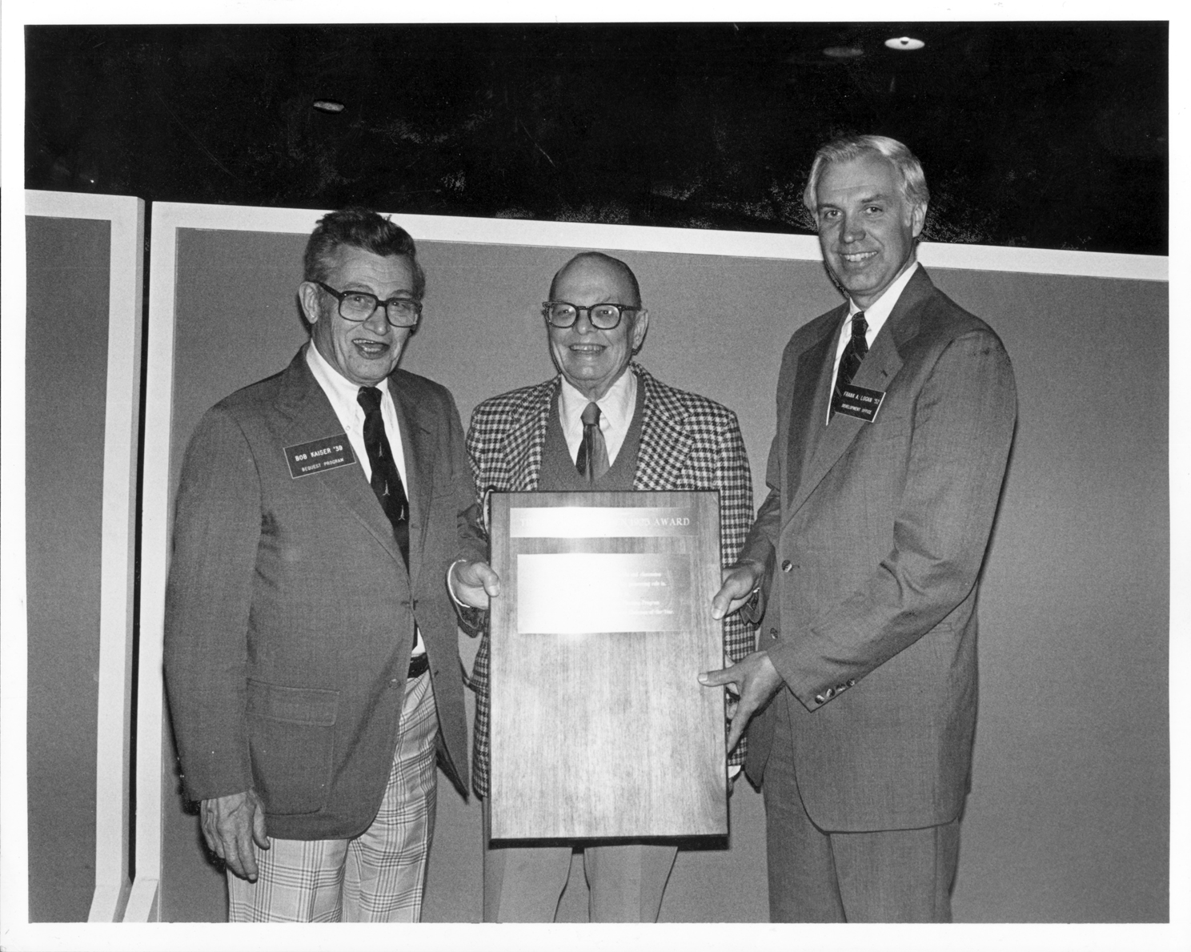
The Ford Whelden ‘25 and Robert Kaiser ‘39 Award
Notes:
Regina to recognize Hank Amon ‘65

Slide 6
Fiscal Year 2015 Results

Slide 7
Gift Planning Impact: FY15 vs FY14
 | FY15 | FY14
Total Future Dollars | $45.8MM | $191.5MM
Bequest Expectancies | $26.3MM | $185.9MM
Life Income Plans & Additions | $5.1MM | $1.1MM
Dartmouth Donor Advised Fund | $15.2MM | $4.5MM
Total Realized Dollars | $21.4MM | $25.1MM
Realized Bequests & Terminated Life Income Plans | $13.6MM | $18.2MM
Outright Gifts and Outside Trust Receipts | $7.8MM | $6.9MM
Notes:
Total future dollars – If we take out $150MM bequest from FY14, we’re right on track with last year. Thanks to you and your efforts, which Julie will review in a minute, we nearly doubled the number of bequest expectancies this year. That being said, only 40% of alumni who told us that Dartmouth was included in their estate plans revealed the present value of their gift. Therefore, the $26.3M only reflects the present value of 40% of the bequest expectancies that we received this year. As a result, we’re trying to do a better job of educating alumni about why we want to know the present value and we’ll talk more about this later today.
Life Income Plans – Darius will speak more about life income plans, so I will not go into the details. Suffice it to say, we are doing very well on this front.
DDAF – We continue to see the popularity of DDAFs increase, which is wonderful for Dartmouth, as at least 50% of these funds have to be distributed to the College. A number of alumni from classes in the 1980s and 1990s established DDAFs this year. These particular alumni seemed to like the DDAF, as it gave them a charitable tax deduction, which they needed, but also allowed them time to determine what causes they would like to support. We also expect that some alumni are using the DDAF as a holding tank for future campaign gifts.
Realized – As you know, we don’t have any control over these numbers. Our focus is on increasing the bequest expectancy pipeline, which we’ve done with your help, to ensure that realized bequests continue to come in in the future.
(Margo: approx. ½ of bequests are unrestricted)

Slide 8
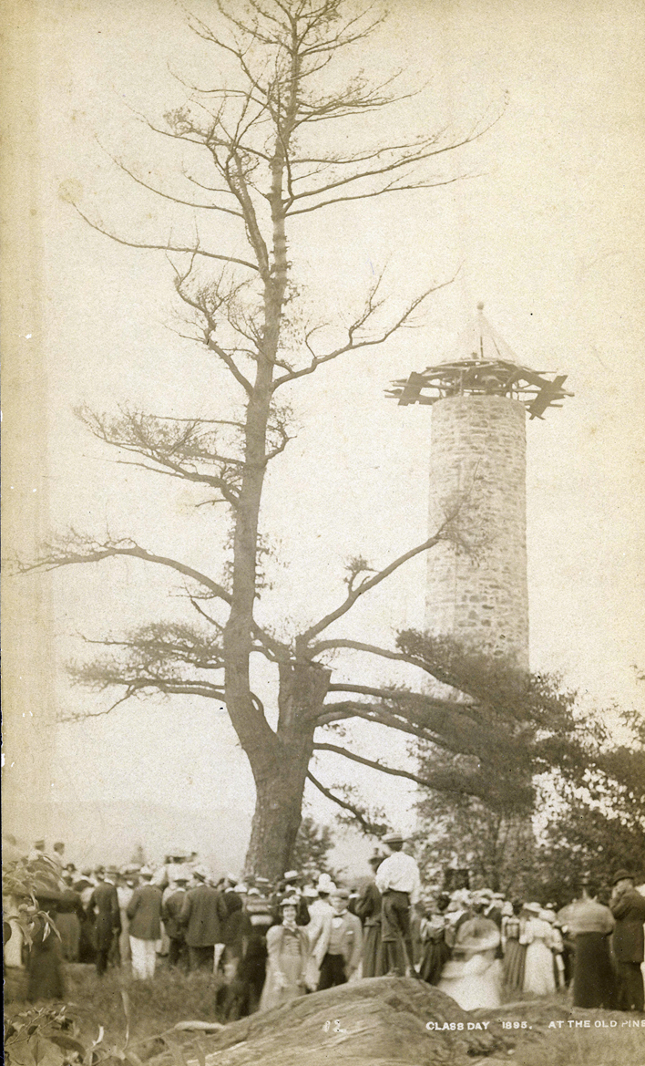
BTS Facts & Figures
221 new members to the Bartlett Tower Society
(50% increase over FY 2014)
48% of new memberships were facilitated by a Gift Planning Chair
Approximately half of new members contacted by a Chair were in reunion
24% of all new members were in classes ’80 or younger; 15 alumni joined from classes ‘90 or younger
9% of new memberships were created through the establishment of a life income plan
18% or 40 members became BTS posthumously
Total number of BTS members is 3,740; 1,613 active and 2,127 deceased
Notes:
Congratulations
Using tools from last year’s COW – Making the Ask!
We tried focusing on reunion classes this year with great success
Younger alumni are becoming interested in BTS – 1990 25th reunion got 5 members with no chair – the word is getting out there!
As you saw earlier, LIP’s were up and with that came an increase in BTS participation
Missed opportunities to steward and thank these generous donors

Slide 9
Summary of Outreach Efforts
Fiscal Year 2015 | Number of Efforts | Details
Gift Planning Office | 17 | Postcards, DAM ads, buck slips, and emails highlighting BTS, CRUT, CGA
Class Newsletters | 32
Class Websites | 4
Targeted Letters | 24 | Targeted Executive Committee, Top 100, Consistent DCF Donor, Hal Ripley, Legacy, Parents
Targeted Emails | 9 | Focus on “low-hanging fruit”, class-wide CGA solicitation
Daily D | 2 | Working closely with head agents and class manager in DCF
DAM – Class Notes | 4 | Work with class secretary
Other | 7 | Display board, holiday and thank you cards, Facebook
Notes:
Personal thank you for all your hard work, made a significant impact on the Gift Planning Program results
GPO efforts – samples up front
82 total chair efforts – really followed the Best Practices we reviewed last year
Newsletters – include pictures, testimonials, ’79; sample in folder
Websites – Goals displayed, easy steps - ’74
Targeted letters/emails – smaller groups, easier to do essential follow up
Daily D – work with DCF Class Manager ‘65 & ‘85 along with head agents – reunion classes around March/April
DAM – introduction to chair, personal story
Other – stewardship
Introduce Darius Long – Life Income Plan Manager – overview life income plan options

Slide 10
Life Income Plans

Slide 11
Charitable Gift Annuity aka “CGA”
Description
- The charitable gift annuity is a simple contract between the donor and Dartmouth. In exchange for assets irrevocably transferred to the College for its eventual use, one or two annuitants receive regular fixed payments for life, backed by the resources of the College.
Benefits
- Gifts can be made with cash or marketable securities; $10,000 minimum
- Guaranteed fixed income for life for one or two annuitants
- Charitable tax deduction in the year of the gift
- Deferred gift annuity is available for younger donors who wish to postpone payments
- Specify the eventual College use for the remainder once the annuity terminates
Good Prospects
- 65 and older
- Alumni in reunion; charitable deduction amount is counted towards class’s 5-year total
- Donors wanting guaranteed supplemental income once retired; deferred annuity works well

Slide 12
CGA Examples
Overview of Dartmouth’s Gift Annuity Pool
- There are currently 232 charitable gift annuity contracts in the College’s pool
- Current market value of the pool is $8.3MM
- Nine gift annuities were established in FY15 totaling $250K in cash and appreciated securities
- $773K in terminated gift annuity dollars realized in FY15
CGA Gift Example
- Charitable gift annuity for Donor A ’42 established in FY03 with $62,000 in securities
- 9.7% annuity began making quarterly payments December 31, 2002
- Immediate charitable tax deduction of 45% of the initial gift value (i.e. $28,035)
- In 2015, the contract terminated and $52,000 was given to the Hopkins Center for current priorities

Slide 13
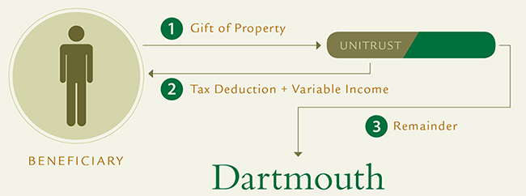
Charitable Remainder Unitrust aka “CRUT”
Benefits
- Gifts can be made with cash, marketable securities, real estate; $50,000 minimum
- A variable income stream for life, or a term years, for the donor or other beneficiaries/successors
- Charitable tax deduction in the year of the gift and reduced estate tax liability
- The opportunity for the payments/trust to grow over time without capital gains liability
- Option to make additions to the trust
Good Prospects
- Prospects interested in a supplemental retirement fund that can grow and receive additions
- Prospects looking to support multiple schools/charities
- Prospects with real estate or privately held stock that aren’t generating income
- Prospects with relatives/friends for whom they want to provide financial support

Slide 14
CRUT Examples
Overview of Dartmouth’s CRUT portfolio
- There are currently 151 charitable remainder unitrusts in the College’s portfolio
- Current market value is approximately $72MM
- Eleven CRUT’s were established in FY15 totaling $4.8MM in real estate, appreciated securities, and cash
- $2.7MM in terminated unitrust dollars realized in FY15
CRUT Gift Example -
CRUT established by Donor B ’47 with $60,245 in securities in FY83
- Trust paid 5% of its market value annually to the donor and his wife for life
- Immediate charitable tax deduction of 29% of the initial gift value (i.e. $17,280)
- Multiple additions over the years totaling $560,755 were made to the trust
- In FY15, $1.7MM was transferred to the College to be used by President Hanlon for top priorities

Slide 15
Pooled Income Fund aka “PIF”
Pooled Income Funds are trusts that combine gifts from individual donors for investment purposes and pay out a proportionate share of the fund’s annual net income
Benefits
- Gifts can be made with cash or marketable securities; $10,000 minimum
- Income for life for one or two beneficiaries and the option to make additions
- Charitable tax deduction in the year of the gift, generally higher than the CGA or CRUT
- The opportunity for the payments to grow over time
- Specify the eventual College use for the remainder once the trust terminates
Good Prospects
- Prospects interested in a modest supplemental retirement fund
- Prospects looking to maximize the remainder gift to Dartmouth
- Prospects who are more interested in the tax deduction than the income stream

Slide 16
PIF Examples
Overview of Dartmouth’s Pooled Income Funds
- The College maintains three pooled income funds
Samson Occom Pool seeks significant long-term growth
John Ledyard Pool provides moderate growth and ample current yield
Old Pine Pool is designed for a higher current yield while maintaining a high degree of stability
- Current combined market value of the pooled funds is $21MM
- One PIF was established and one addition was made in FY15 totaling $101K in cash and appreciated securities
- $837.7K in terminated pooled income fund dollars realized in FY15
PIF Gift Example -
Samson Occom PIF set up by Donor C ’46 with $57,700 in securities
Established in FY94 to benefit the donor’s sister and brother-in-law
Immediate charitable tax deduction of 36% of the initial gift value (i.e. $20,700)
In FY15, the trust was terminated and $162,405 was used to establish a DCF endowment for the Class of 1946

Slide 17
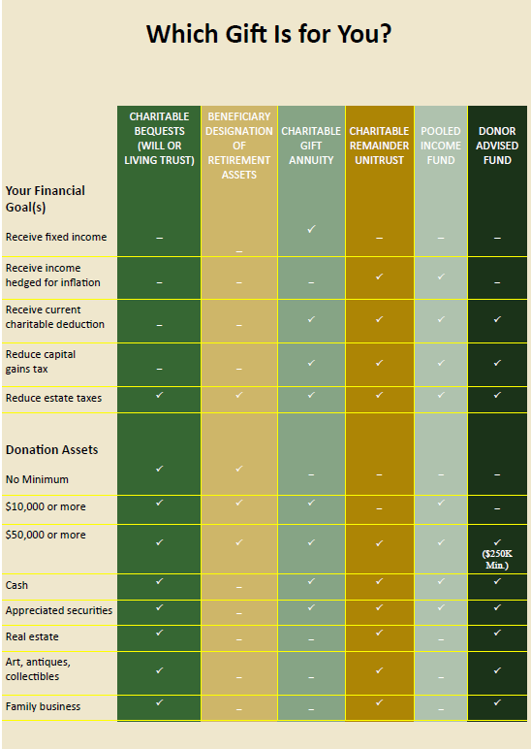

Slide 18
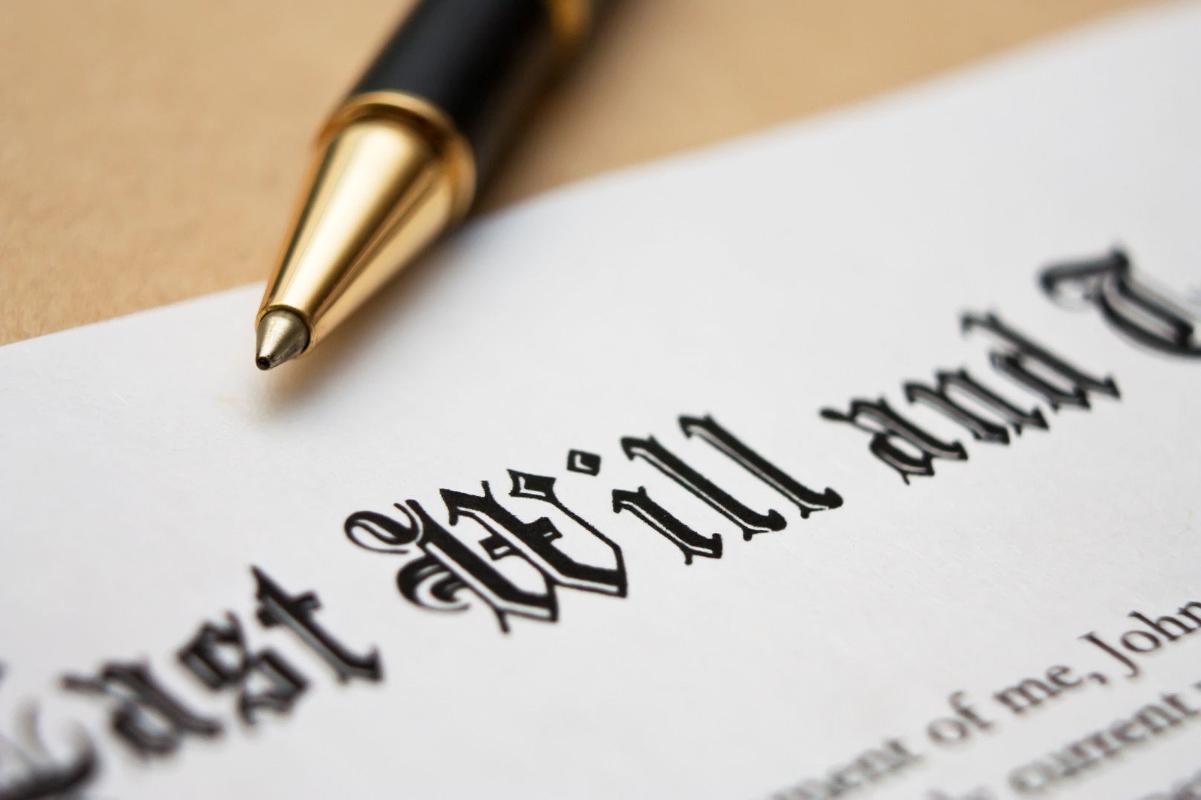
Desired Bequest Documentation
Notes:
As you can see, we’re going to talk about bequest documentation in this section.
Before we get started, there are a few things that I want to mention to make sure that we’re all on the same page:
When we use the term bequests, we mean that Dartmouth has been named as a beneficiary of a:
Will or living trust
Retirement account
Life insurance policy
All bequests are revocable and can be changed at any time.
Bequests do not have to be a certain size – alumni can leave Dartmouth $100 or $1M through bequests.

Slide 19
What details do we want and why? (i.e. What do we need to make someone BTS?)
Copy of will/beneficiary designation form:
- Verifies that plans include Dartmouth
- Answers questions about restrictions and contingencies
Bequest amount (optional)
Notes:
What details do we want to collect and why? In other words, how does one qualify for BTS membership?
We like to obtain a copy of the will, living trust, or beneficiary designation form. All we need is the page that pertains to Dartmouth, all other information can be redacted.
We ask for this documentation because it verifies that Dartmouth is in fact a beneficiary of the donor’s estate plans.
As we all know, following through on one’s intention to include Dartmouth in their estate plans can take a while. By asking for a copy of the documentation, we ensure that we’re only recognizing alumni who have actually included Dartmouth, rather than those who intend to do so.
Additionally, being able to see the bequest document helps us answer questions about restrictions and contingencies. As you know, when you ask Julie make someone BTS, she often asks you if the gift is restricted or contingent. By receiving a copy of the bequest documentation, we’re able to answer these questions by simply reviewing the document and there’s no need to go back and forth with the donor.
We’ll talk more about restricted gifts in just a minute, but I’d like to take a minute to explain why we want to know whether or not the bequest is contingent.
Most wills are written so that money is distributed to family, friends, and charities after both spouses have passed away. This type of contingency is totally fine and is referred to as a spousal contingency or mirror will.
There are some plans that we call ‘Disaster Plans’ in which the donor’s family and friends must predecease him/her in order for Dartmouth to receive anything. With this type of contingency, it’s clear that the donor doesn’t want Dartmouth to receive the bequest, as they would never want this to happen, and we wouldn’t want to receive a bequest in this manner either.
So the question that we ask when deciding whether or not a gift is contingent, and if we should extend BTS membership, is: does the donor actually want Dartmouth to receive the gift.
In addition to receiving a copy of the donor’s will, living trust, or beneficiary designation form, we would also like to know the amount of the bequest, which we’ll talk about in greater detail in the next two slides.

Slide 20
Why it’s in the donor’s best interest to provide these details?
Bequest documentation
Ensures that we can uphold donor’s wishes
Bequest amount
Prompts endowed fund conversation
Please help us reinforce this message
Notes:
We just reviewed what details we want to collect, but now let’s talk about why it’s in the donor’s best interest to provide us with this information.
The bottom line is that sharing the bequest documentation with our office protects the donor’s interests.
Because bequests are often a donor’s largest gift and a way to pass along their values, it’s very important that Dartmouth understand how the donor would like his/her bequest to be used. By working with our office to draft or review the bequest language, the donor can be assured that we will honor his/her wishes when they’re no longer with us.
The reason why it’s so important for us to have this conversation while the donor is still alive is that wills, living trusts, and beneficiary designation forms are all legally binding documents. Upon receipt of a bequest, Dartmouth will be required to use the funds according to the language that was used in the bequest document, regardless of other notes that we may have on file or conversations that we’ve had with the alumni. If the eventual purpose of a bequest is such that it cannot be used, the gift would either need to be relinquished or Dartmouth’s general council would have to go to the NH attorney general and request a change in the restriction. We try to prevent this from happening by working with the donors to understand their intentions and make sure that their bequest documentation properly reflects their wishes.
Here’s an example of a bequest where we didn’t have an opportunity to work with the donor.
Many years ago, a donor’s bequest was used to establish an endowed fund for ‘firewood at the President’s House’. I’m sure that the donor didn’t really mean to make this gift so restrictive; at the time, firewood was probably just what was used to heat most buildings. But, because the donor’s will is a legally binding document, Dartmouth is legally obligated to use the income from the endowed fund to purchase firewood. Had we had the opportunity to work with the donor while he was still alive, we would have suggested that the language be made more flexible by changing the wording to something like ‘to be used to cover the cost of heating of the President’s House, with first priority given to firewood’.
This leads me to my next point about why it’s in the donor’s best interest to reveal the size of the bequest, especially if the eventual purpose of the gift is restricted.
Many bequest donors like the idea of their gift supporting the college in perpetuity. However, they don’t realize that there are certain thresholds and requirements that a gift must meet in order to establish an endowed fund.
Therefore, when a donor is willing to provide us with the size of their bequest we’re able to educate them about their options and they’re often able to structure their gift in a way that will have more impact than they dreamed was possible.
As you’re talking to your peers, if you could please help us reinforce this message, that would be great. By asking all of these questions, we’re not trying to be nosey, we simply want to understand the donor’s wishes and protect their interests.

Slide 21
How Dartmouth uses these details
Helps the College plan for the future
Allows us to thank and engage the alumni during their lifetime
Inspires and motivates others to do the same
Notes:
Let’s briefly talk about how Dartmouth uses all of the information that it collects from the bequest documentation.
First, we like to know the bequest amount because it helps Dartmouth plan for the future.
We understand that bequests are revocable and can always change. However, when we know the approximate value of bequest expectancies, we can provide leadership with a rough estimate of future income that Dartmouth will receive as bequests are realized. This assists the financial team as they budget for programming and other costs.
Second, knowing that a donor has included Dartmouth in his/her estate plans allows us to thank and engage that person during their lifetime
Alumni who leave bequests to the College are unable to see the impact of their gift. Therefore, we want to know about their bequest so that we can thank them during their lifetime and possibly involve them in whatever they are passionate about.
Finally, we’re able to use the stories of those who have made a bequest to inspire others to do the same
As you’re well aware, alumni are inspired by their peers. Therefore, being able to say that x number of alumni have made bequests or we anticipate receiving x dollars from future bequests, we’re able to promote these gifts and inspire others to take the steps to include Dartmouth in their estate plans.
To end, I thought that I would show you some samples of bequest documentation.

Slide 22
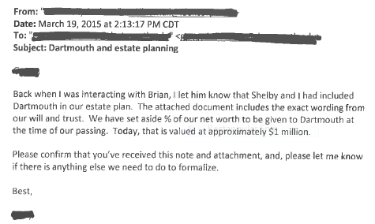
Sample documentation (will or living trust)
(Screen shot of will)
Notes:
Here is a copy of a donor’s will in which Dartmouth is named as a 5% beneficiary of the alumnus’ Trust. The bequest is designated to an endowed scholarship fund that the alumnus established in 2014, but the donor has included an alternate use clause if the scholarship fund is no longer in existence when the bequest is received.
The donor sent the Gift Planning office this documentation attached to an email and within the email included the value of the Trust - $1M and we know that Dartmouth is getting 5% of that, so $50,000.

Slide 23
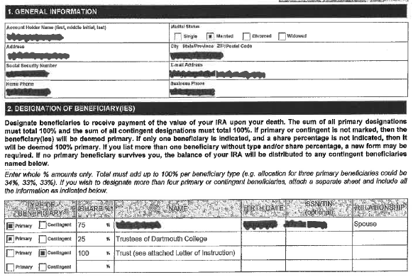
Sample documentation (retirement account or life insurance policy)
Notes:
Here is a copy of a donor’s beneficiary designation form. Dartmouth has been named as a 25% beneficiary of this alumnus’ IRA account. In this instance, the gift is unrestricted and alumni did not provide us with an approximate bequest value. If the gift were restricted in any way, we would follow up with the donor to ensure that we could honor his/her wishes.

Slide 24
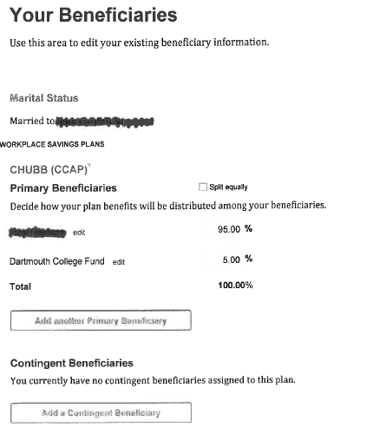
Sample documentation (retirement account or life insurance policy)
Notes:
Here’s another example of a beneficiary designation form. The legal name is Trustees of Dartmouth College, but we receive many like this and we make it work.
Conclusion: I hope that you have found this to be helpful. In your folder, there’s a one page document which includes the bequest language for wills, living trusts, retirement accounts, and life insurance policies. Please feel free to distribute this one page document to your peers who inquire about bequests.

Slide 25
The Anatomy of a Successful BTS Reunion Campaign
Plan Ahead!
Talk to Classmates!
Be Creative!
Wish Big!
Give it Heart!
Write Personal Notes!
Spare No One!
Engage!
Feed BTS Info!

Slide 26
Format a Strategy
Schedule a strategy session with Gift Planning Office
- Begin campaign one to two (or more!) years out
- Share ideas with Class President and Head Agent
- Maintain consistent contact with GPO for updates and support
Set Reunion Goals
- Include class leadership on goal setting
- Be challenging but realistic
- Cluster competition
- Goal of “50 by 50th”, “30 by 30th”, double your class BTS membership, etc.
- Try to break current record
Notes:
We talked earlier of the success of focusing on reunion classes and setting goals this past year; share some tools that you can apply to your next reunion to make it a success for your class and Dartmouth – “Help Me, Help You”
‘77 – two years out; ‘88 3 years out and ‘74 4 years out
Having class leadership behind you in your goal is key, they will help be ambassadors for the BTS; expose more prospects; 2002 Chair
1 of me and 44 classes - We are here to Help! I will be your best friend!
Everyone loves a goal – people respond to goals; make yours just as important as DCF/Participation
Help get the message out there
Something to achieve – let’s work together on something you can accomplish and, as a class, be proud of
Phil Kron ‘60 – the most – 82 since Class of ‘34 – to 100!
Many requested the record of most BTS members at reunion – did research and able to go back 15 years with available data – in packet

Slide 27
16 Yr Bartlett Tower Society Reunion Results
25th Reunion |  |  | 30th Reunion |  |  | 35th Reunion |  |  | 40th Reunion |  |  | 45th Reunion |  |  | 50th Reunion
Class | # BTS Members |  | Class | # BTS Members |  | Class | # BTS Members |  | Class | # BTS Members |  | Class | # BTS Members |  | Class | # BTS Members
1990 | 10 |  | 1985 | 19 |  | 1981 | 6 |  |  |  |  |  |  |  | 1965 | 50
1989 | 3 |  | 1984 | 12 |  | 1980 | 35 |  | 1975 | 7 |  | 1969 | 28 |  | 1964 | 45
1988 | 8 |  | 1983 | 12 |  | 1979 | 27 |  | 1974 | 16 |  | 1968 | 26 |  | 1963 | 30
1987 | 4 |  | 1982 | 12 |  | 1978 | 13 |  | 1973 | 21 |  | 1967 | 25 |  | 1962 | 29
1986 | 10 |  | 1981 | 5 |  | 1977 | 16 |  | 1972 | 14 |  | 1966 | 27 |  | 1961 | 29
1985 | 7 |  | 1980 | 13 |  | 1976 | 22 |  | 1971 | 17 |  | 1965 | 17 |  | 1960 | 43
1984 | 9 |  | 1979 | 8 |  | 1975 | 7 |  | 1970 | 14 |  | 1964 | 30 |  | 1959 | 37
1983 | 8 |  | 1978 | 7 |  | 1974 | 8 |  | 1969 | 25 |  | 1963 | 21 |  | 1958 | 33
1982 | 9 |  | 1977 | 8 |  | 1973 | 14 |  | 1968 | 21 |  | 1962 | 22 |  | 1957 | 32
1981 | 2 |  | 1976 | 14 |  | 1972 | 12 |  | 1967 | 16 |  | 1961 | 22 |  | 1956 | 28
1980 | 6 |  | 1975 | 5 |  | 1971 | 10 |  | 1966 | 21 |  | 1960 | 25 |  | 1955 | 28
1979 | 4 |  | 1974 | 3 |  | 1970 | 11 |  | 1965 | 14 |  | 1959 | 23 |  | 1954 | 30
1978 | 2 |  | 1973 | 13 |  | 1969 | 15 |  | 1964 | 22 |  | 1958 | 20 |  | 1953 | 49
1977 | 6 |  | 1972 | 7 |  | 1968 | 16 |  | 1963 | 21 |  | 1957 | 22 |  | 1952 | 54
1976 | 8 |  | 1971 | 7 |  | 1967 | 14 |  | 1962 | 22 |  | 1956 | 24 |  | 1951 | 46
1975 | 3 |  | 1970 | 10 |  | 1966 | 22 |  | 1961 | 17 |  | 1955 | 19 |  | 1950 | 24
 | 99 |  |  | 155 |  |  | 248 |  |  | 268 |  |  | 351 |  |  | 587
Average = 6 |  |  | Average = 10 |  |  | Average = 16 |  |  | Average = 18 |  |  | Average = 23 |  |  | Average = 37

Slide 28
DCF/Gift Planning Relationship
Open Communication with Head Agents and
Class Manager
- Be a part of Reunion Giving Committee
- Pay attention to DCF mailing schedule
- Over 70% of BTS memberships are consistent DCF givers
Successful DCF/Gift Planning Partnerships
- Hank Amon ‘65
- Beth Hobbs ‘85
Notes:
More and more class leadership is recognizing the benefits of combining DCF/BTS solicitation
Be on calls, Exposes you to many classmates, some may not be able to give a big DCF gift but can supplement that with a planned gift
Don’t over saturate donors; make your solicitation stand out
Feel confident in asking to become BTS knowing they will still give to annual fund
Thought we would share a couple examples of this and how well it worked for them
Hank and Beth share experiences

Slide 29
Year-Long Efforts
Newsletters
- Check with Class Newsletter Editor for schedule
- Include goal, pictures, testimonials
Dartmouth Alumni Magazine – Class Notes
- Work with Class Secretary for submission dates
- Make quote personal and exciting, include goals
Website
- Create BTS page on class website
- Include photo, personal statement, goal, contact info, and class BTS listing
- Keep updated
Facebook
- Update with new members, photo, brief testimonial, link to class website
Daily D
- Work with Head Agents and DCF Class Manager
Notes:
I’m here to help every step of the way
Newsletters – typically during reunion they pump up the number of issues – be in them! Less text, eye catching
DAM – everyone reads! Build relationship with secretary – make BTS
Website – 12 out of 45 classes; work with webmaster, draft from GPO
Facebook – Do you have a page?
Daily D – focuses on class giving; comes out around March for reunion classes; include BTS goals

Slide 30
Targeted Efforts
Class Officers/Executive Committee; “Lead by Example”
- Personal email, letter, or phone call
- Participate in class leadership calls
- FOLLOW UP!
Top Donors
- Work with Head Agent – Comprehensive Ask
- Most likely already have Dartmouth in estate plans
- Letter with personal note
- FOLLOW UP!
Consistent DCF Givers
- Majority of current BTS members
- Giving Today, Keep Giving Tomorrow
- FOLLOW UP!
Smaller, Defined Prospects
- Life Income Plans, Undocumented, Couples, Legacy, Profession, Affinity
- FOLLOW UP!
Notes:
Most successful process is solicit, follow up, feedback, refer to me, on prospect list til we close gift
Executive Committee – campaign is working – 1/3 of members this weekend are BTS; ‘59 has most members; secretary hold out; class president on letter too
Top Donors – Work with DCF
DCF Givers – Over 70% BTS
LIP – CGA depending on age, Low-Hanging Fruit, Couples – Regina, Lawyers/estate planners, Greek
Class-wide effort – for the right reasons, new class, unfamiliar with BTS; kick off to reunion campaign
_____________________________________________________________________________________________________________
Now, I would like to have Frank Logan from the Class of ‘52 share with us a little history about our beloved Bartlett Tower and about the wonderful gift his class has recently made towards the restoration of this beloved icon of Dartmouth.

Slide 31
Follow Up Leads to

Slide 32
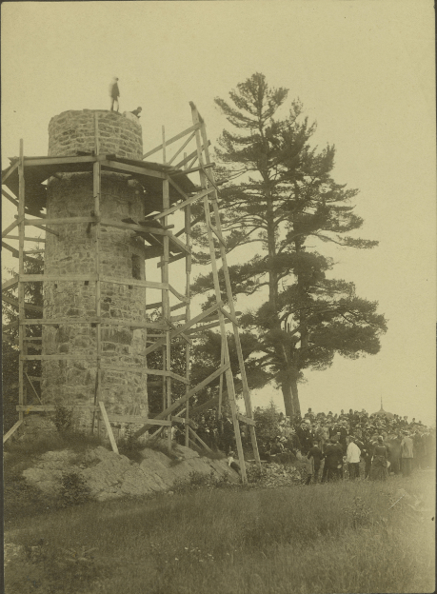
History of the Bartlett Tower

Slide 33
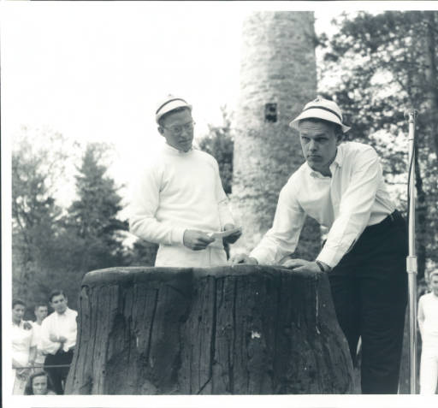
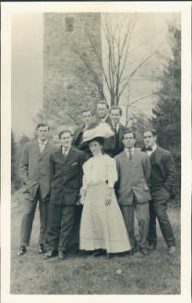
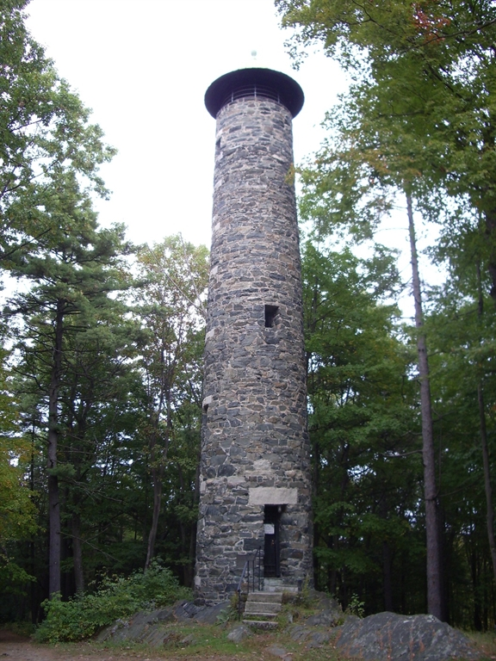
The Tower Through the Years

Slide 34
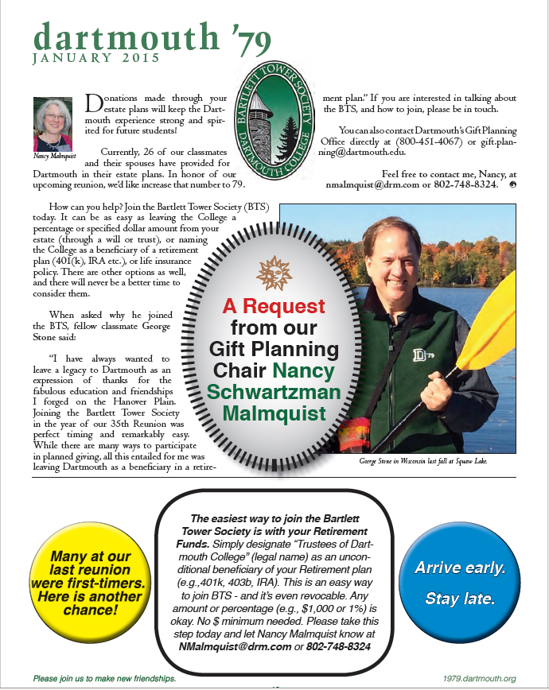
1979 Newsletter

Slide 35
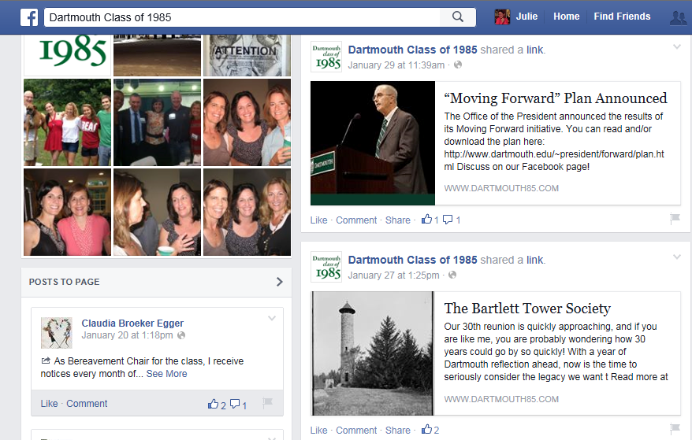
1985 Facebook Page

