Slide 1
Dartmouth for All:
Engaging Young Alumni
Notes:
NBL: Welcome & introduce self
TSC: Introduce self & info about to provide is based on research from PEW & other government sources

Slide 2
Objective
Define Millennials (Gen Y) and Generation Z
What are they looking for from Clubs, Groups and Alumni Relations?
What would attract them to leadership?
Notes:
TSC: Review objectives
In order to understand YA, need to understand generation that they are coming from.
How they are engaged and what they want from us.
How to engage them in leadership roles and how to manage them in leadership roles.

Slide 3
Young Alumni
Millennials
Born in early 1980s- mid 1990s
Generation Z
Born in mid 1990s-early 2000s
43% non-White
Gravitate towards group activities
Technologically skilled
Increase of new graduates with student loan debt (Today, at more than $1trillion, student loans now compromise the largest debt in America, surpassing credit card debt)
Phone calls are considered too invasive. Mail? Forget it. Their lives are centered around mobile devices
Loyalty challenge, tend to leave positions after 2 years
Increase in consumer-driven alumni who expect value-added benefits and accountability
Women have almost always outnumbered men on college campuses
Gen Z is the most ethnically diverse generation in US history with 47% ethnic minorities
They prefer snack media, 8 seconds attention span
Communication style is visual, suffer from FOMO (Fear of Missing out)
They’re also twice more likely to use YouTube than Millennials, and a lot less likely to use Facebook
These consumers are digital natives, but even more so, mobile first.
They demand transparency
Notes:
Provide overview of each generation.
Millennial - NBL
Provide examples of activities
Be conscious of price points for activities b/c of student loan debt
Mobile communication
Frequent movers (2 yr) in both professional and volunteer roles
Gen Z - TSC
FOMO
Give it to me now and give it to me quick
Want transparency b/c media they grew up with has been transparent – i.e. people on the ground reporting / recording with mobile – translates to workplace, communications, peers

Slide 4
Best Practices
Millennials
Identify young alumni who can be your “recruiters”
Create events that specifically add value to their professional or personal lives
Generation Z
Let them be co-creators of their experience
Create Snack Media
Consider comping their registration if they bring 5 friends to an event
Speak in Images
Notes:
Millenials - NBL
They need to recruit one another
Respect recruiter’s positions/tiles but respect peers more and being recruited by someone they can identify with
Incentivize recruiting peers to attend events
Want value added events
Gen Z – NBL
Want to create / have a say in what they are attending
Ask their opinion
Host events where they get to do something
Publicize with short / quick / visual
Longwinded emails won’t work with this group
Survey Info
Educational
Professional Development
Civic Engagement / Social Responsibility
Social Programming (always works)

Slide 5
Recruiting for Leadership
Millennials & Generation Z
Encourage Innovation
Give them Freedom and flexibility, don’t hover
Appreciate them
Anticipate breaks for personal and professional reasons
Demonstrate how they can help make an impact
Explain Value-Add
Be very transparent
Notes:
TSC:
Be ok with new ideas and the success or failure that comes with those ideas.
Give time fit tasks into their schedules – i.e. allow a few weeks and don’t hover
Express thanks in multiple ways
Busy lifestyles
How does their work help move the organization forward and what will they get out of assisting?
Transparency – always – feel uncomfortable and unsafe when you aren’t transparent with them

Slide 6
Breakout
Four Groups-Two Events
Welcome to the City
Professional Event for Young Alumni
Roles
Moderator- Moderates questions
Writer- Writes answers
Presenter- Presents information
Questions (20 mins. Breakout, 5mins. Presentation)
How would you get people to be engaged in planning the event?
Describe the type of event
What would happen at the event?
How would you market the event?
Describe the location and venue for the event?
Will you request YADA funding to support the event?
Notes:
Welcome to City Description – TSC – Share example from groups
Professional Development Description – NBL – Share example from CA MBA programs
Roles – TSC
Questions – NBL
Goal is to develop a toolkit “boxed” program that organizations can take away to implement when they go home.

Slide 7
Presentations
Four Groups-Two Events
Welcome to the City
Professional Event for Young Alumni
Questions
How would you get people to be engaged in planning the event?
Describe the type of event
What would happen at the event?
How would you market the event?
Describe the location and venue for the event?

Slide 8
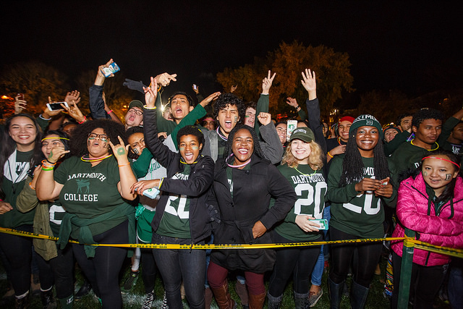
Questions/Comments

