Slide 2
iModules Introduction, Possibilities and Next Steps
Olivier Gilloux Trainer and Applications Specialist Information Management Systems and New Media for Advancement Lesley Thompson Trainer and Applications Specialist Information Management Systems and New Media for Advancement
Notes:
Presenter: Lesley Thompson

Slide 3
Agenda
Overview of iModules
Review services provided by the Alumni Help Desk
Review new onboarding process
Review (CMS) website management tool
Review email tool
Introduce event tool
Introduce membership tool
Financials
Q&A
Resources & Next Steps
Notes:
Presenter: Lesley Thompson

Slide 4
Overview of iModules
iModules is a software and engagement company based in Kansas. iModules has over 900 clients worldwide including Dartmouth, Princeton, MIT and Notre Dame.
iModule’s Encompass platform is a software application suite which includes:
alumni online community
email marketing communications
online giving
event registration/management
ecommerce
content management system (CMS)
Notes:
Presenter: Olivier Gilloux

Slide 5
Alumni Help Desk Services
The Alumni Help Desk provides assistance with the use of Dartmouth online services and applications used by Dartmouth alumni and alumni volunteers.
NEW! Alumni Help Desk website The Alumni Help Desk website is a comprehensive training, support, and customer service website for alumni who need assistance with the Dartmouth online systems and services available to alumni. alumnihelpdesk.dartmouth.org
Notes:
Presenter: Lesley Thompson

Slide 6
Onboarding Process
NEW! To start the onboarding process for your club or group, go to: dartmouth.imodules.com/onboarding
If your club or group is already using iModules, and you would like to request new administrator access, go to: dartmouth.imodules.com/volunteeradmin
Mark Hoffman (Associate Director for Operations, Communities) is the point-person in Alumni Relations for any questions, onboarding requests or administrator access requests.
Notes:
Presenter: Olivier Gilloux

Slide 7
CMS (Website Management)
Customizable templates
Responsive template option (mobile friendly)
Example of club website: Dartmouth Club of NY
URL: nyc.dartmouth.org
Customizable content
College-provided content
Notes:
Presenter: Lesley Thompson

Slide 8
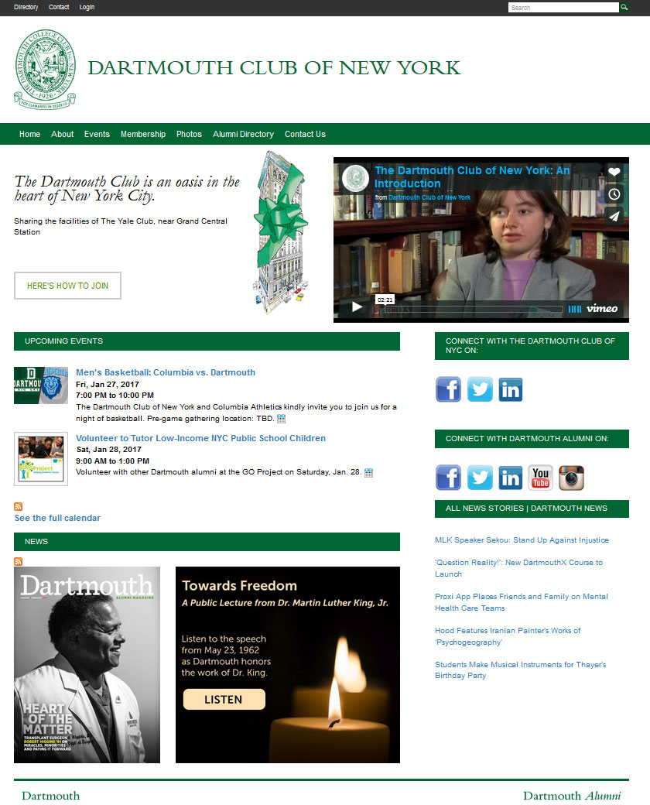
Example of club website
Notes:
Presenter: Lesley Thompson

Slide 9
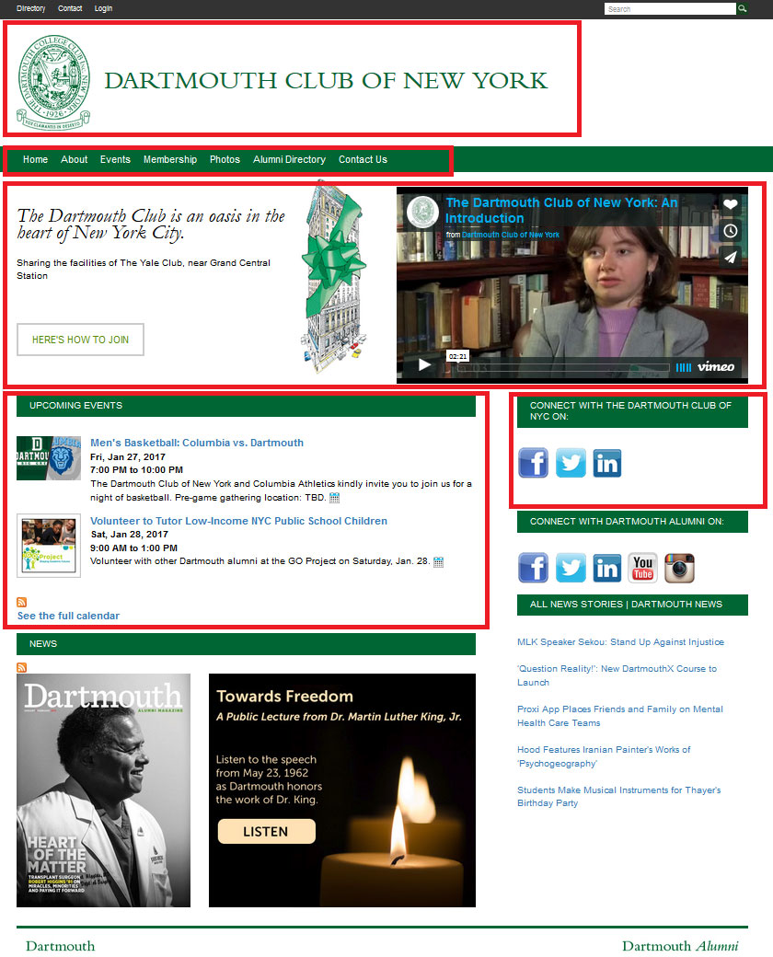
Customizable content
Notes:
Presenter: Lesley Thompson

Slide 10
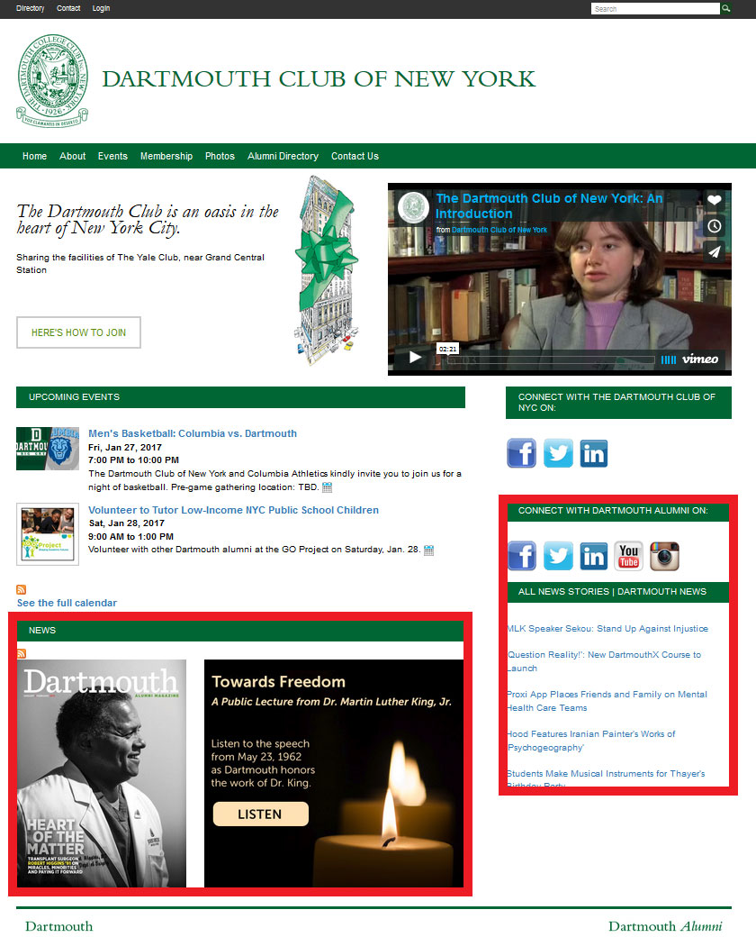
College-provided content
Notes:
Presenter: Lesley Thompson

Slide 11
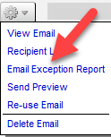
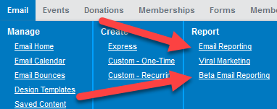
Email Communications
Reporting
Email Exception Report (from Email History)
Email Reporting vs. Beta Email Reporting
Metrics available
Notes:
Presenter: Olivier Gilloux

Slide 12
Email Communications
Mobile Awareness
Choose Template > Mobile Ready Single Column w/ Header & Footer > D Mobile Single Column
Images
<img class="mFullImage" src="http://...
Alt text
Saved content
Notes:
Presenter: Olivier Gilloux

Slide 13
Email Communications
Segmentation
Choose Recipients > Data Viewer > Configure
Use a criteria template > Query by undergrad class year
More to come
Notes:
Presenter: Olivier Gilloux

Slide 14
Event Management
NEW! Request an event registration form: dartmouth.imodules.com/eventrequestform
Different types of event forms
Managing the event registration
Resend a confirmation email
Cancel a registrant’s participation
Export the attendee list
Admin confirmation emails
Reports
How to register for someone
How to modify an existing registration
Notes:
Presenter: Lesley Thompson

Slide 15
Membership
Requirements gathering:
Existing membership data
Desired membership levels/terms
Form layout and copy
Features
Promotion codes
Additional contributions
Website and email integration
Notes:
Presenter: Olivier Gilloux

Slide 16
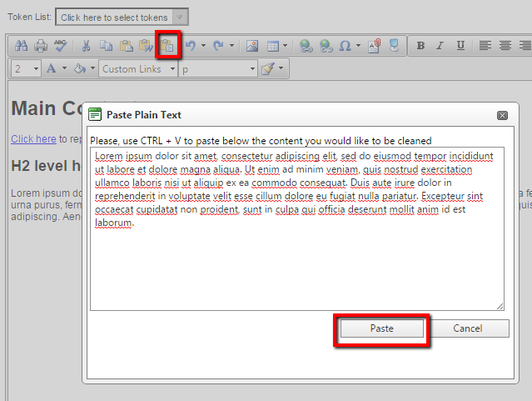
Best Practices
Images
Crop image and reduce overall file size before you upload.
Use “save for web” whenever possible to help the image be quicker (and easier!) to download.
Formatting
Avoid using tables. Tables are not mobile-friendly or responsive.
Avoid changing the style of text (e.g., color, font, font size) when using the Content Editor. Use the styles that are part of your template.
Don’t copy & paste directly from a webpage, email or Microsoft Word UNLESS you use the “paste as plain text” option.
White space is easier on the eyes!
Notes:
Presenter: Lesley Thompson

Slide 17
Best Practices
Emails
Keep subject line short and to the point.
Keep text and body copy to a minimum. Include a few sentences, then add a link to the full article on your website.
Include 2-3 photos when appropriate, to engage with the reader.
Use visual cues, such as horizontal rules or a larger font for headlines, to indicate new topics.
Keep mobile in mind! Over half of your recipients will open the email on a mobile device.
Use effective email categories (i.e. Club Newsletter, Club Events, Club Meeting Notices)
White space is easier on the eyes!
Notes:
Presenter: Lesley Thompson

Slide 18
Financials
Collections & disbursement of monies
FAQ available at http://dartmouth.imodules.com/help
Refunds
http://dartgo.org/volunteerrefund (login required)
Transaction fee (2.5%)
Reconciliation reports
Notes:
Presenter: Olivier Gilloux

Slide 19
Q&A

Slide 20
Resources & Next Steps
Alumni Help Desk Contact Information (603) 646-3202 | (855) 215-9024 (toll free) Mon. - Fri. 9 AM - 10 PM EST | Sat.- Sun.10 AM - 6 PM EST Help@Dartmouth.edu | alumnihelpdesk.dartmouth.org
iModules Volunteer Resources Website dartmouth.imodules.com/help
Onboarding process dartmouth.imodules.com/onboarding
iModules administrator access dartmouth.imodules.com/volunteeradmin
How to make your website responsive dartmouth.imodules.com/responsiveupgrade

